Slide 1
Chapter 1
Reviewing Functions

Slide 2
Linear Functions
1.1

Slide 3
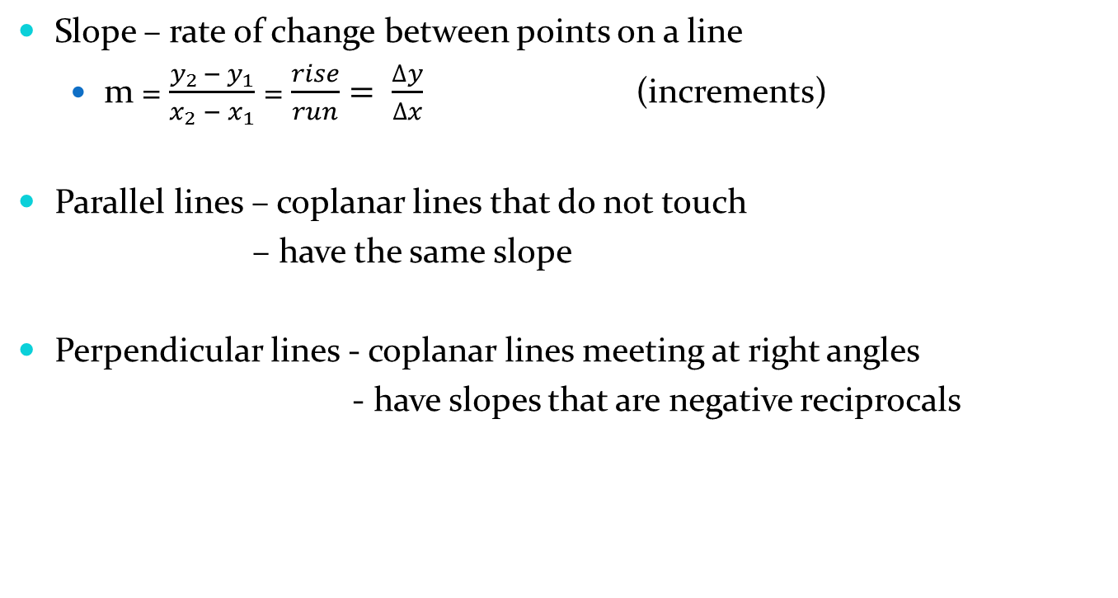
1.1 Linear Functions
Slope – rate of change between points on a line
  m = $\frac{y_{2 }− y_{1}}{x_{2} − x_{1}}$ = $\frac{rise}{run}= \frac{∆y}{∆x}$ (increments)
Parallel lines – coplanar lines that do not touch
– have the same slope
Perpendicular lines - coplanar lines meeting at right angles
- have slopes that are negative reciprocals

Slide 4
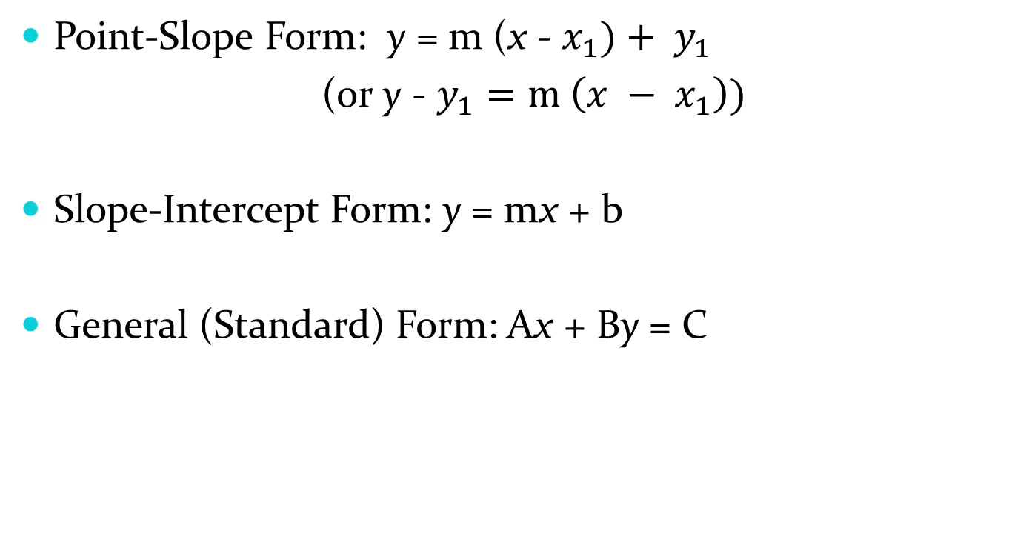
1.1 Linear Functions
Point-Slope Form: y = m (x - $x_{1})+ y_{1}$
(or y - $y_{1}=m \left(x − x_{1}\right))$
Slope-Intercept Form: y = mx + b
General (Standard) Form: Ax + By = C

Slide 5
1.1 Linear Functions
Example: Write the equation of the line parallel to the line passing through (2, 3) and (3, 5) and passing through (3, 4) in Point-Slope, Slope-Intercept, and General Form.
Example: Write the equation of the line perpendicular to the line passing through (-2, 1) and (0, -5) and passing through (1, 1) in P-S, S-I, and General Form.

Slide 6
1.1 Linear Functions
Example: Find the slope and y-intercept of 7x + 3y = 16. Graph the line.
Horizonal and Vertical Lines: horizontal lines take the form y = c while vertical lines take the form x = c
Example?
Assignment: pg. 9 (1-44, 47-52, 54)

Slide 7
Functions
1.2

Slide 8
1.2 Functions
function – each independent variable (x) assigned
only one dependent variable (y)
function of – defining the dependent variable in terms
of the independent variable
domain – possible values of the independent variable
range – possible values of the dependent variable

Slide 9
1.2 Functions
Example: Is d = 2r a function? If so, which variable is a function of the other? What is its domain and range?
even function – symmetric about the y-axis
f(-x) = f(x)
odd function – symmetric about the origin
f(-x) = -f(x)

Slide 10
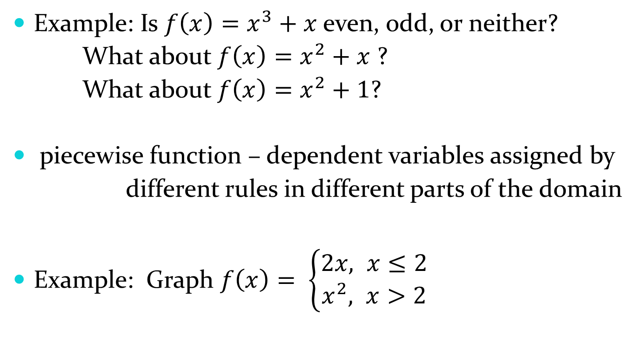
1.2 Functions
Example: Is $f\left(x\right)=x^{3}+x$ even, odd, or neither?
What about $f\left(x\right)=x^{2}+x$ ?
What about $f\left(x\right)=x^{2}+1$?
piecewise function – dependent variables assigned by
different rules in different parts of the domain
Example: Graph $f\left(x\right)= \left\{\begin{aligned}2x, x≤2 \\ x^{2}, x>2\end{aligned}\right.$

Slide 11
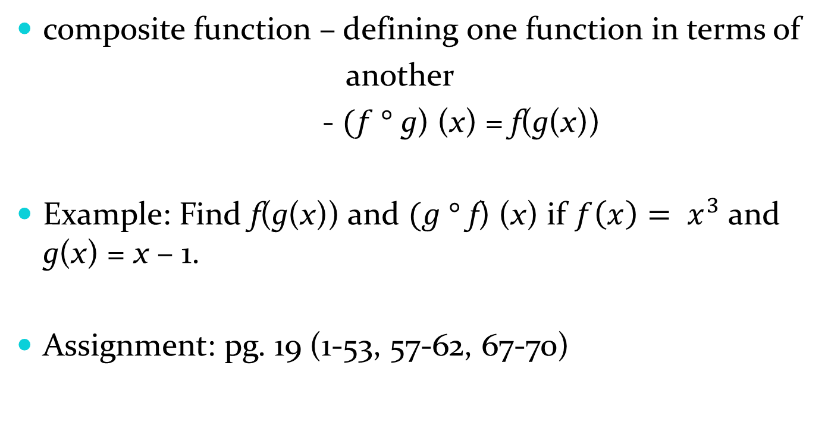
1.2 Functions
composite function – defining one function in terms of
another
- $(f °$ g) (x) = f(g(x))
Example: Find f(g(x)) and $(g °$ f) (x) if $f\left(x\right)= x^{3}$ and g(x) = x – 1.
Assignment: pg. 19 (1-53, 57-62, 67-70)

Slide 12
Exponential Functions
1.3

Slide 13
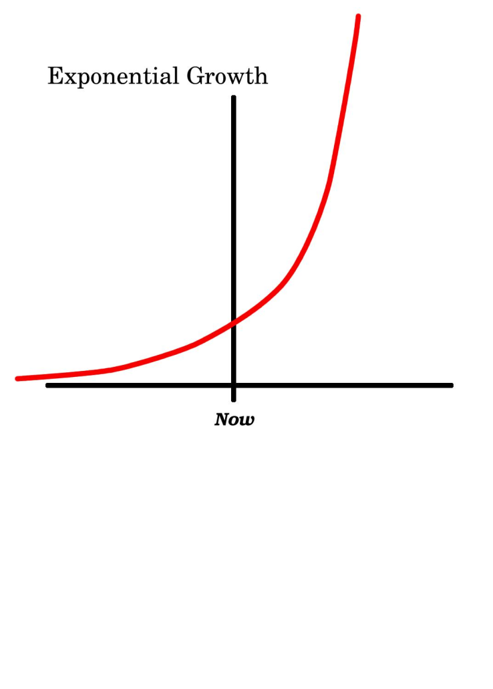

1.3 Exponential Functions
Exponential Functions: $f\left(x\right)= a^{x}$ (a a constant)
Exponential Growth : a > 1 (e is “special”)

Slide 14
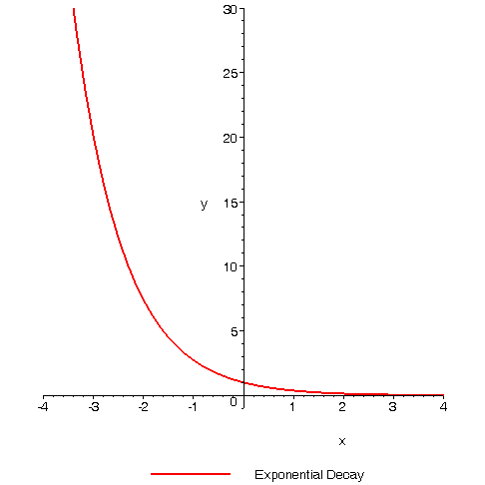
1.3 Exponential Functions
Exponential Decay: 0 < a < 1

Slide 15
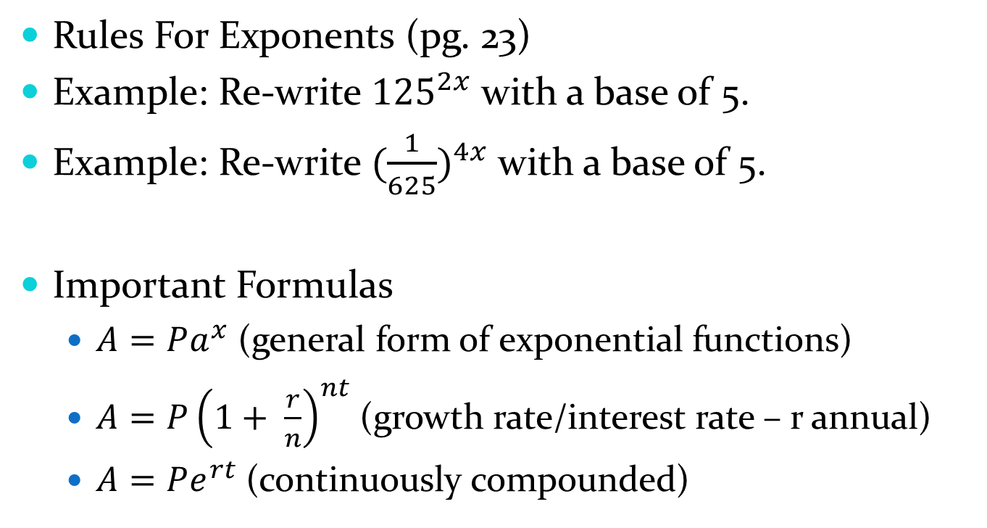
1.3 Exponential Functions
Rules For Exponents (pg. 23)
Example: Re-write ${125}^{2x}$ with a base of 5.
Example: Re-write ${(\frac{1}{625})}^{4x}$ with a base of 5.
Important Formulas
  $A=Pa^{x}$ (general form of exponential functions)
  $A=P{\left(1+ \frac{r}{n}\right)}^{nt}$ (growth rate/interest rate – r annual)
  $A=Pe^{rt}$ (continuously compounded)

Slide 16
1.3 Exponential Functions
Example: The population of Rauschville is 20,000 and increasing at a rate of 2.34% each year. When will the population reach 100,000?
Example: How long does it take an investment to double if interest is earned at a rate of 6% compounded annually, monthly, daily, and continuously?
Assignment: pg. 26 (1-32, 38, 41-49)

Slide 17
Inverses
(featuring Logarithms)
1.5

Slide 18
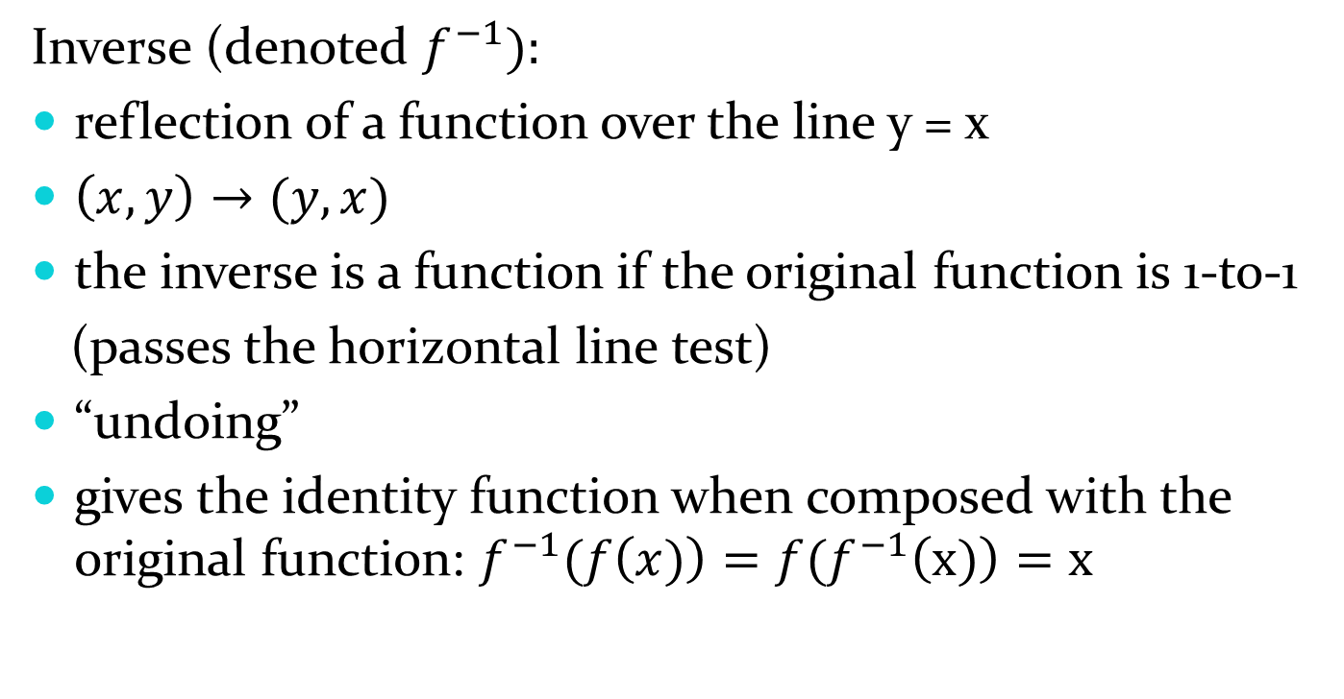
1.5 Inverses
Inverse (denoted $f^{−1}):$
reflection of a function over the line y = x
$\left(x, y\right)→(y, x)$
the inverse is a function if the original function is 1-to-1
(passes the horizontal line test)
“undoing”
gives the identity function when composed with the original function: $f^{−1}(f\left(x)\right)=f(f^{−1}\left(x)\right)=x$

Slide 19
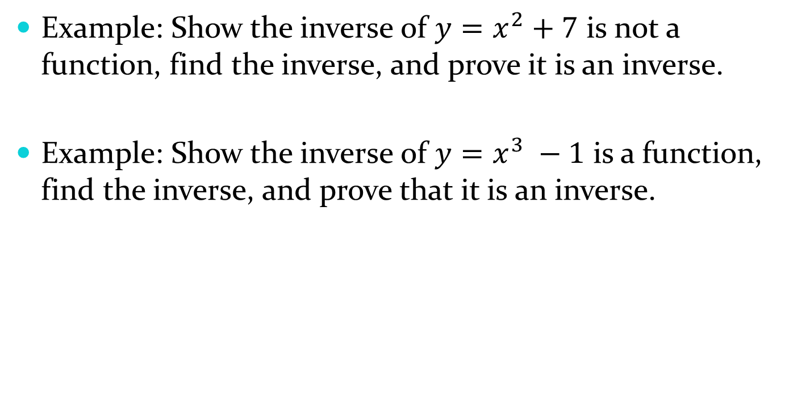
1.5 Inverses
Example: Show the inverse of $y=x^{2}+7$ is not a function, find the inverse, and prove it is an inverse.
Example: Show the inverse of $y=x^{3} −1$ is a function, find the inverse, and prove that it is an inverse.

Slide 20
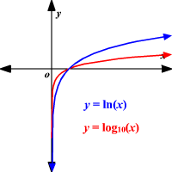
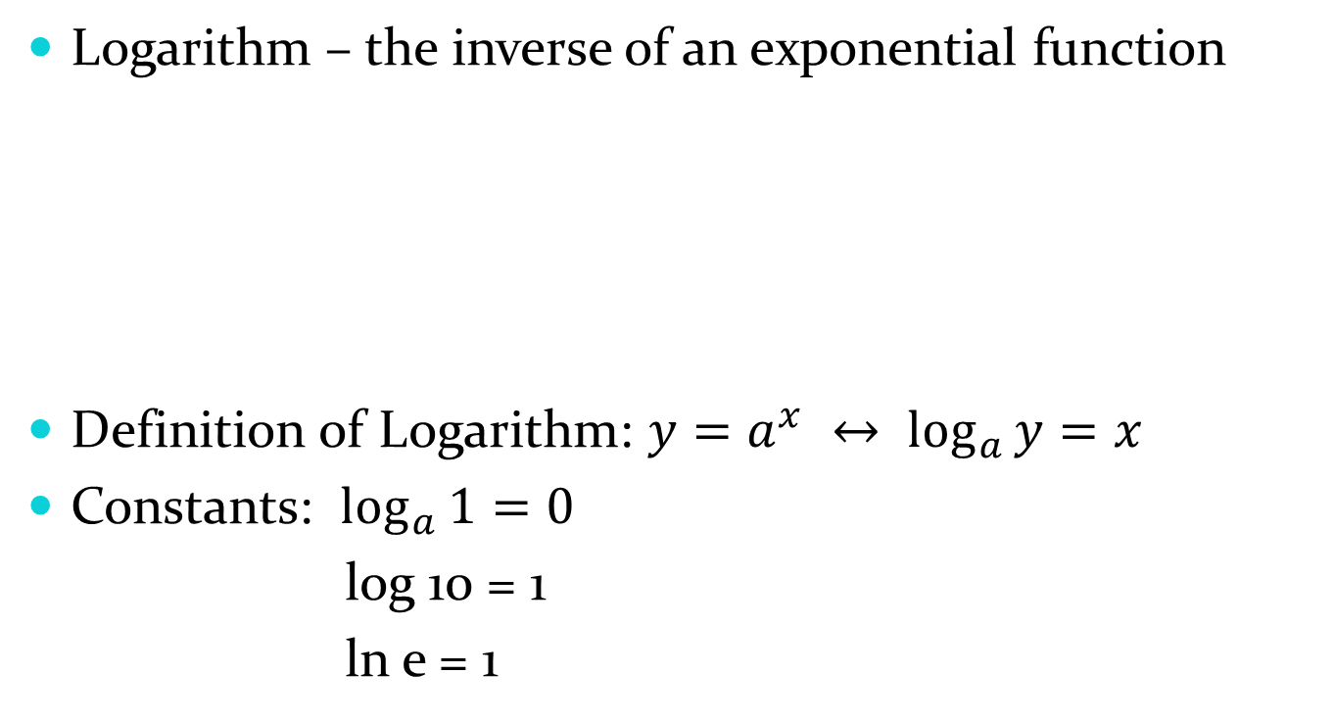
1.5 Logarithms
Logarithm – the inverse of an exponential function
Definition of Logarithm: $y=a^{x} ↔ \log_{a}{y}=x$
Constants: $\log_{a}{1}=0$
log 10 = 1
ln e = 1

Slide 21

1.5 Logarithms
Properties of Logarithms
  $a^{\log_{a}{x}}=x$
  $\log_{a}{a^{x}}=x$
  $\log_{a}{xy= \log_{a}{x}+ \log_{a}{y}}$
  $\log_{a}{\frac{x}{y}= \log_{a}{x} − \log_{a}{y}}$
  $\log_{a}{x^{y}=y \log_{a}{x}}$

Slide 22
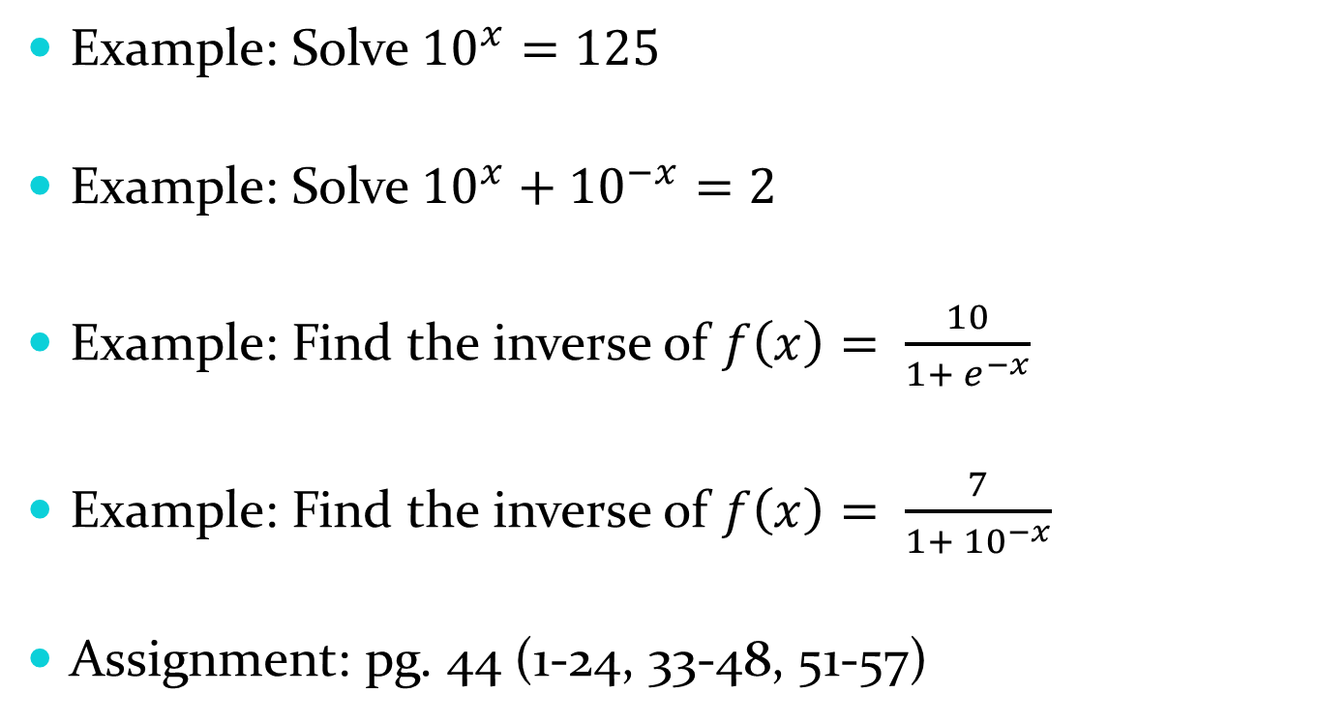
1.5 Logarithms
Example: Solve ${10}^{x}=125$
Example: Solve ${10}^{x}+{10}^{−x}=2$
Example: Find the inverse of $f\left(x\right)= \frac{10}{1+ e^{−x}}$
Example: Find the inverse of $f\left(x\right)= \frac{7}{1+ {10}^{−x}}$
Assignment: pg. 44 (1-24, 33-48, 51-57)

Slide 23
Trigonometric Functions
1.6

Slide 24
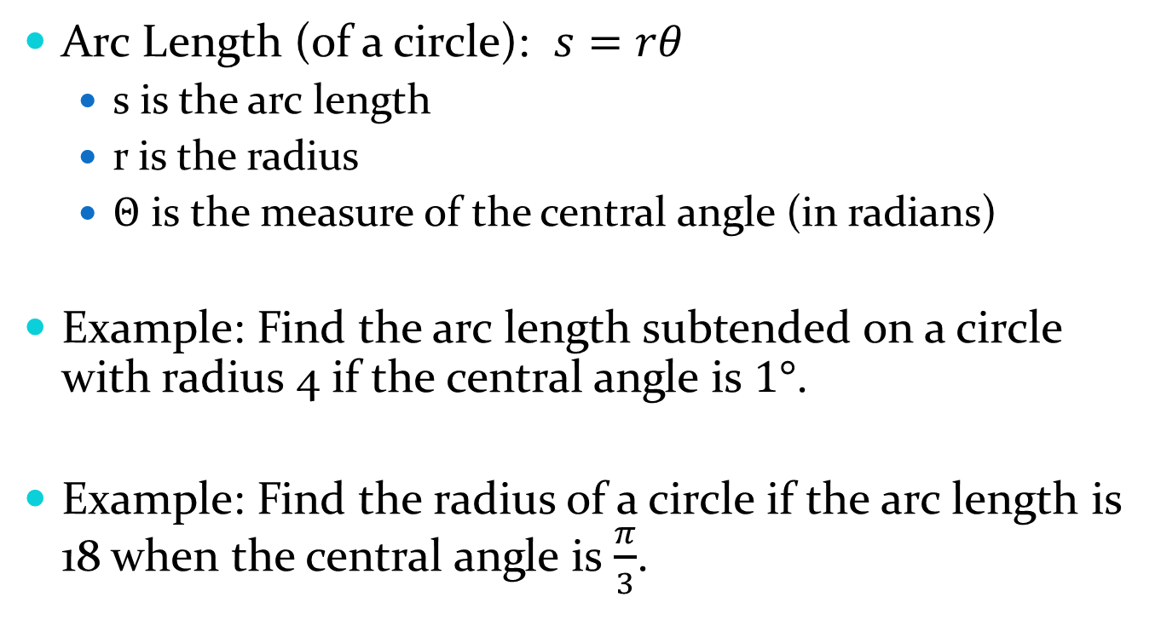
1.6 Trig Functions
Arc Length (of a circle): $s=rθ$
  s is the arc length
  r is the radius
  $Θ$ is the measure of the central angle (in radians)
Example: Find the arc length subtended on a circle with radius 4 if the central angle is $1°$.
Example: Find the radius of a circle if the arc length is 18 when the central angle is $\frac{π}{3}$.

Slide 25
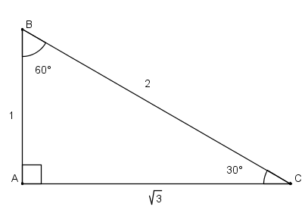
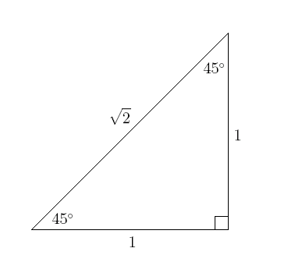
1.6 Trig Functions
Trig ratios
  based on the unit circle (r = 1)
  “sohcahtoa” [ sec x = 1/cos x, csc x = 1/sin x, cot x = 1/tan x]
  30-60-90 Triangle 45-45-90 Triangle

Slide 26
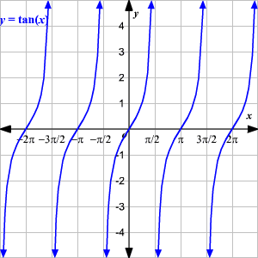
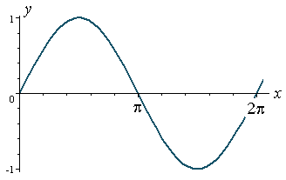
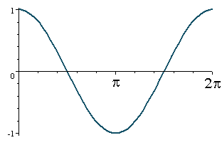
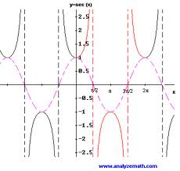
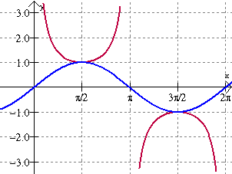
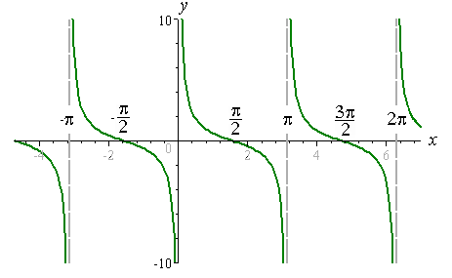
1.6 Trig Functions
Trig graphs (max/min, domain/range)

Slide 27
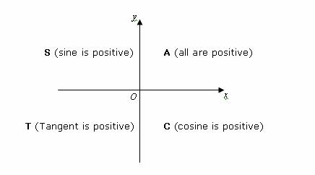
1.6 Trig Functions
Trig translations: y = A sin B(x + C) + D
  A – amplitude
  B – horizontal stretch/shrink (period = “old period”/B)
  C – horizontal (phase) shift
  D – vertical shift
Trig signs:

Slide 28
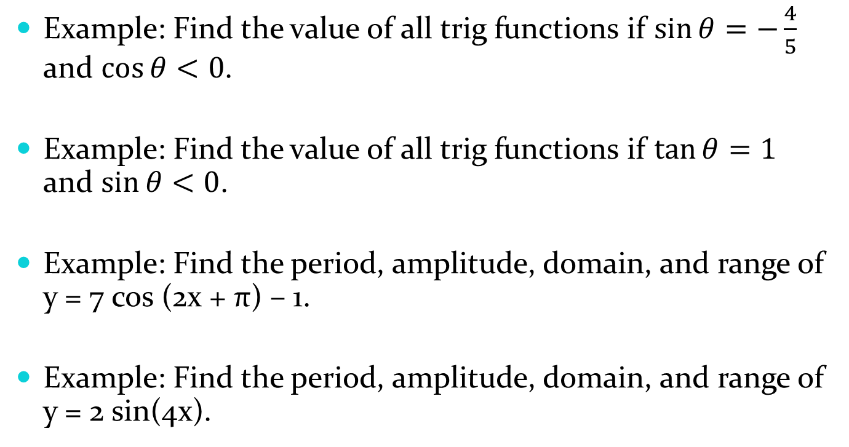
1.6 Trig Functions
Example: Find the value of all trig functions if $\sin{θ=−\frac{4}{5}}$ and $\cos{θ<0}$.
Example: Find the value of all trig functions if $\tan{θ=1}$ and $\sin{θ<0}$.
Example: Find the period, amplitude, domain, and range of y = 7 cos (2x + π) – 1.
Example: Find the period, amplitude, domain, and range of y = 2 sin(4x).

Slide 29
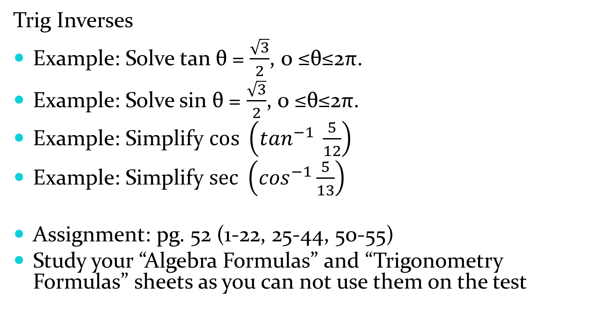
1.6 Trig Functions
Trig Inverses
Example: Solve tan θ = $\frac{\sqrt{3}}{2}$, 0 ≤θ≤2π.
Example: Solve sin θ = $\frac{\sqrt{3}}{2}$, 0 ≤θ≤2π.
Example: Simplify $\cos{ \left(\tan^{−1} \frac{5}{12}\right)}$
Example: Simplify $\sec{ \left(\cos^{−1}\frac{5}{13}\right)}$
Assignment: pg. 52 (1-22, 25-44, 50-55)
Study your “Algebra Formulas” and “Trigonometry Formulas” sheets as you can not use them on the test

