Slide 1
Limits
(no calculator test)
Chapter 2

Slide 2
Introduction to Limits
2.1

Slide 3
2.1 Intro to Limits
Limits, one-sided limits, and continuity)

Slide 4
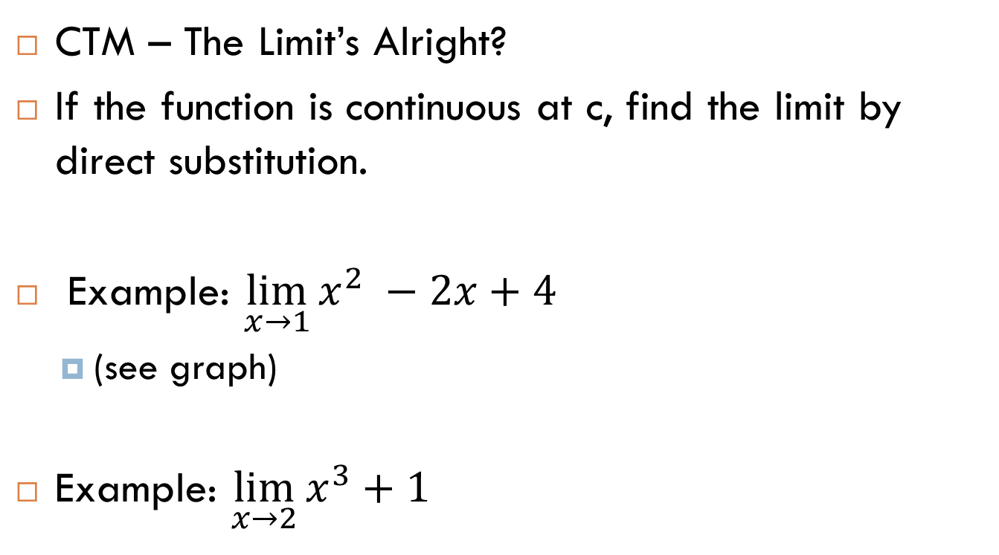
Intro to Limits
CTM – The Limit’s Alright?
If the function is continuous at c, find the limit by direct substitution.
Example: $\lim_{x→1}{x^{2} −2x+4}$
  (see graph)
Example: $\lim_{x→2}{x^{3}+1}$

Slide 5
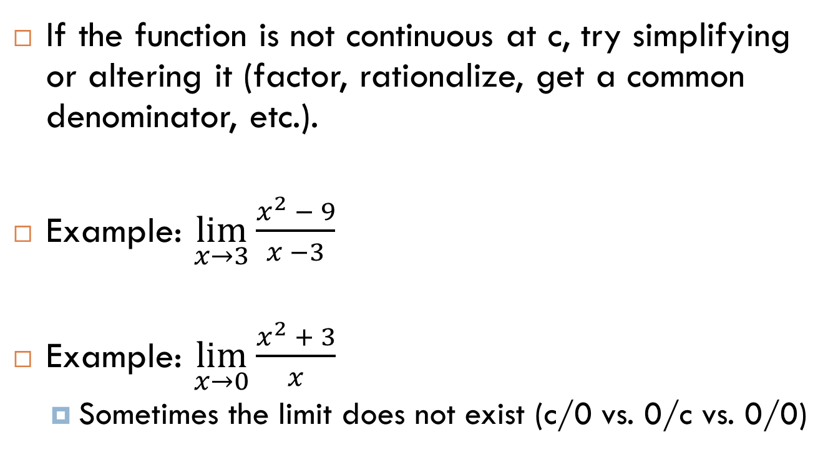
2.1 Intro to Limits
If the function is not continuous at c, try simplifying or altering it (factor, rationalize, get a common denominator, etc.).
Example: $\lim_{x→3}{\frac{x^{2} − 9}{x −3}}$
Example: $\lim_{x→0}{\frac{x^{2} + 3}{x}}$
  Sometimes the limit does not exist (c/0 vs. 0/c vs. 0/0)

Slide 6
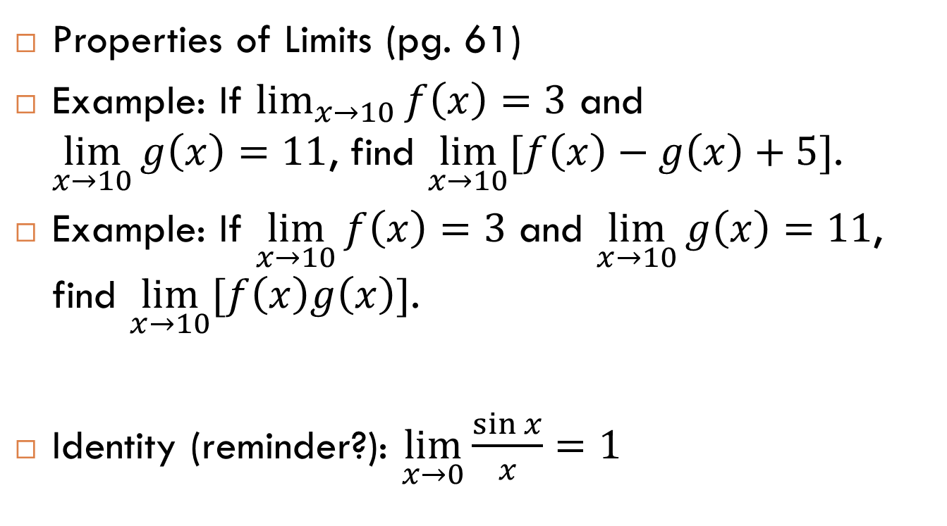
2.1 Intro to Limits
Properties of Limits (pg. 61)
Example: If $\lim_{x→10}{f\left(x\right)=3}$ and $\lim_{x→10}{g\left(x\right)=11}$, find $\lim_{x→10}{[f\left(x\right)−g\left(x\right)+5]}$.
Example: If $\lim_{x→10}{f\left(x\right)=3}$ and $\lim_{x→10}{g\left(x\right)=11}$, find $\lim_{x→10}{[f\left(x\right)g\left(x\right)]}$.
Identity (reminder?): $\lim_{x→0}{\frac{\sin{x}}{x}}=1$

Slide 7
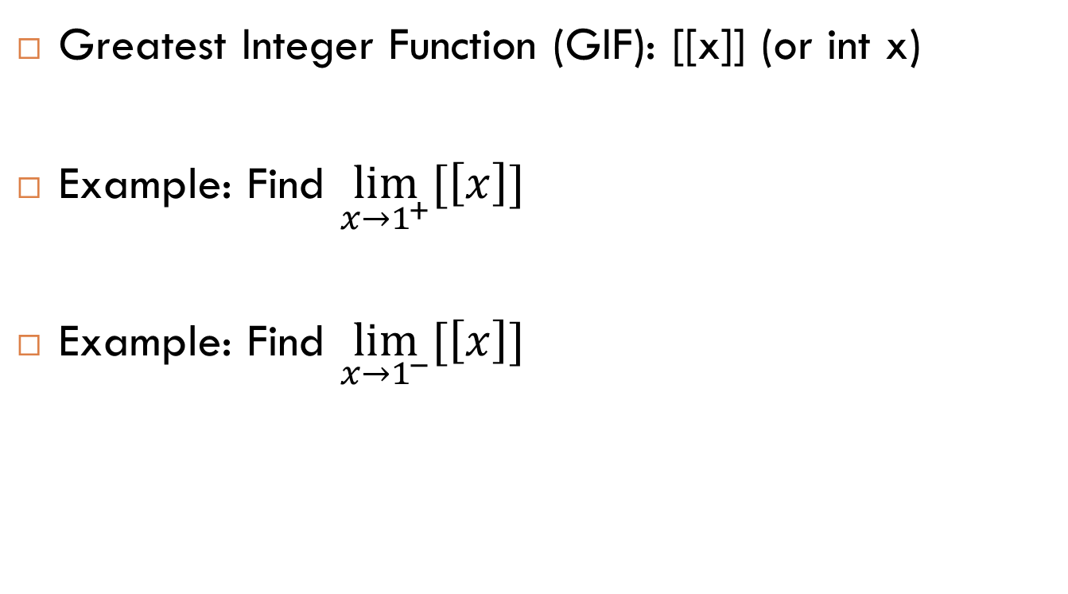
2.1 Intro to Limits
Greatest Integer Function (GIF): [[x]] (or int x)
Example: Find $\lim_{x→1^{+}}{[\left[x\right]]}$
Example: Find $\lim_{x→1^{−}}{[\left[x\right]]}$

Slide 8
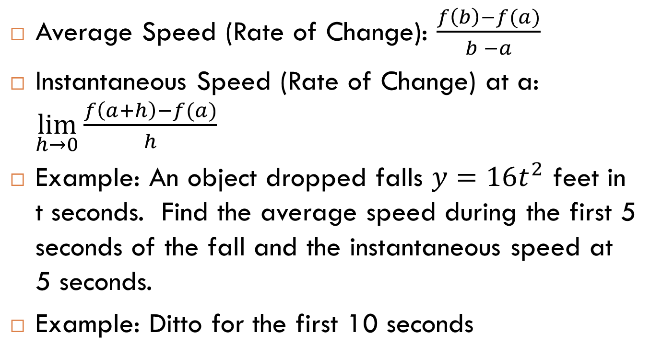
2.1 Intro to Limits
Average Speed (Rate of Change): $\frac{f\left(b\right)−f(a)}{b −a}$
Instantaneous Speed (Rate of Change) at a: $\lim_{h→0}{\frac{f\left(a+h\right)−f(a)}{h}}$
Example: An object dropped falls $y=16t^{2}$ feet in t seconds. Find the average speed during the first 5 seconds of the fall and the instantaneous speed at 5 seconds.
Example: Ditto for the first 10 seconds

Slide 9
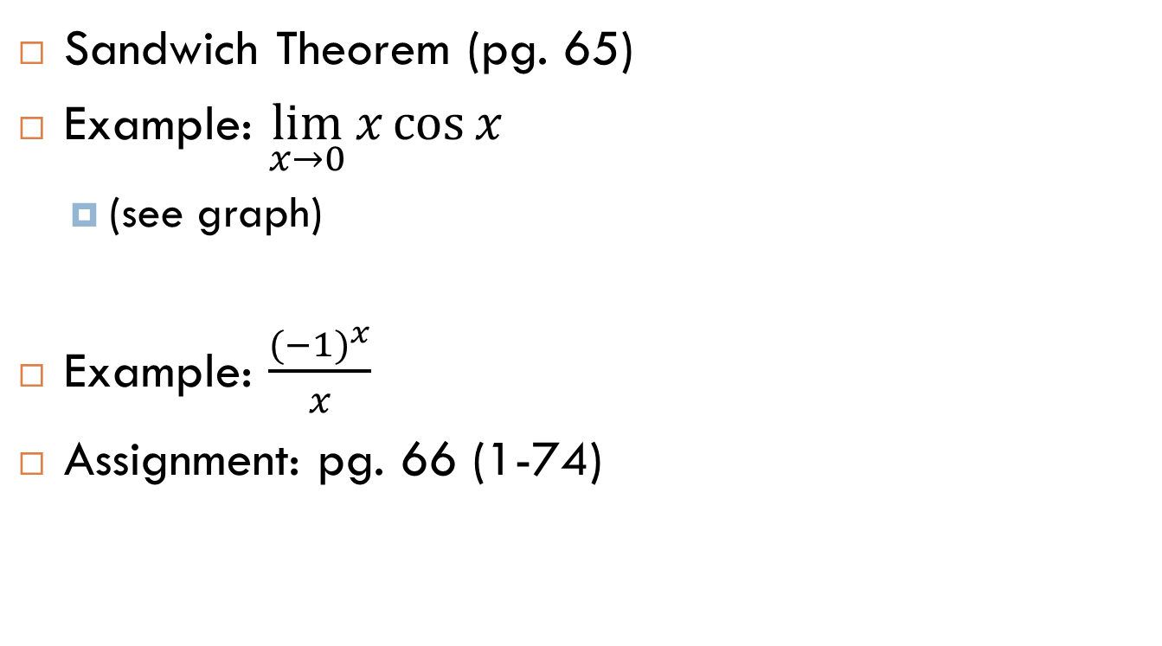
2.1 Intro to Limits
Sandwich Theorem (pg. 65)
Example: $\lim_{x→0}{x\cos{x}}$
  (see graph)
Example: $\frac{{(−1)}^{x}}{x}$
Assignment: pg. 66 (1-74)

Slide 10
Limits – To Infinity and Beyond!
2.2

Slide 11
2.2 Limits Involving Infinity
Infinity – a concept representing a theoretical number so large you can multiply it times 0 and get something other than 0, so large if you add a trillion to it its value does not change, and so large adding itself to its square does not even change its value (it would be really, really big if it really existed)
CTM – 5 Sizes of Numbers?

Slide 12

2.2 Limits Involving Infinity
Examples:
  $\lim_{x → 0^{+}}{\frac{1}{x}}$
  $\lim_{x → 0^{−}}{\frac{1}{x}}$
  $\lim_{x → 1^{−}}{\frac{1}{x −1}}$
  $\lim_{x → 1^{+}}{\frac{1}{x −1}}$
  (see graphs)

Slide 13
2.2 Limits Involving Infinity
End Behavior, Horizontal Asymptotes, and the Sandwich Theorem: You can tell a function’s end behavior by calculating its horizontal asymptotes. This can be done by considering what happens to its graph as x approaches positive AND negative infinity (this find the right- and left-end behavior, respectively). [As with other limits, problems involving the Sandwich Theorem can often be solved by graphing or reasoning algebraically.]

Slide 14
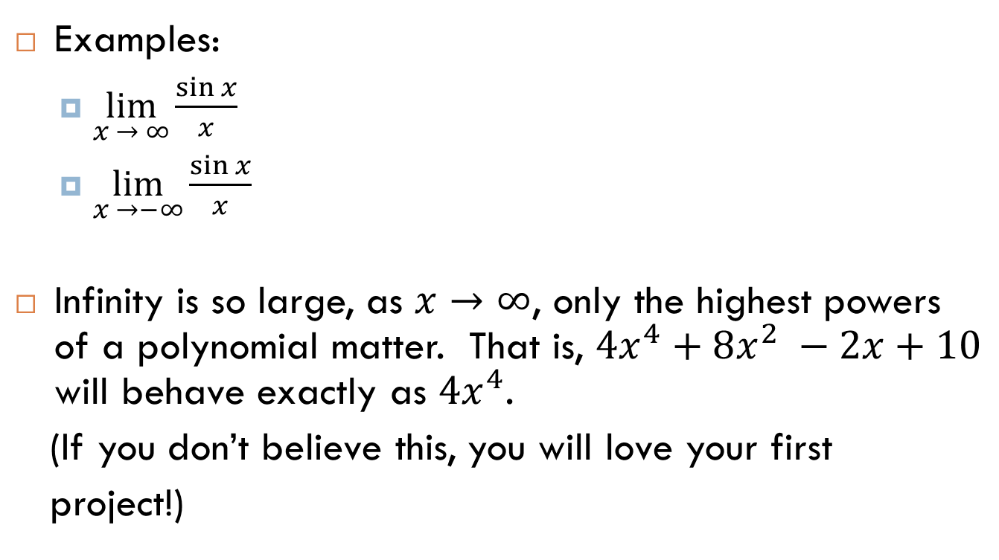
2.2 Limits Involving Infinity
Examples:
  $\lim_{x → ∞}{\frac{\sin{x}}{x}}$
  $\lim_{x →−∞}{\frac{\sin{x}}{x}}$
Infinity is so large, as $x→∞$, only the highest powers of a polynomial matter. That is, ${4x}^{4}+8x^{2} −2x+10$ will behave exactly as ${4x}^{4}$.
(If you don’t believe this, you will love your first
project!)

Slide 15
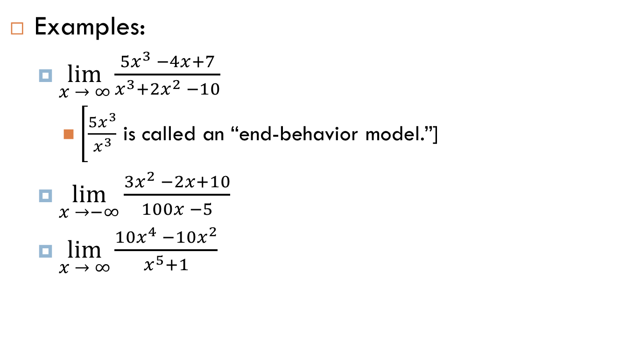
2.2 Limits Involving Infinity
Examples:
  $\lim_{x → ∞}{\frac{5x^{3} −4x+7}{x^{3}+2x^{2} −10}}$
    $\left[\frac{5x^{3}}{x^{3}}\right.$ is called an “end-behavior model.”]
  $\lim_{x →−∞}{\frac{3x^{2} −2x+10}{100x −5}}$
  $\lim_{x → ∞}{\frac{10x^{4} −10x^{2}}{x^{5}+1}}$

Slide 16
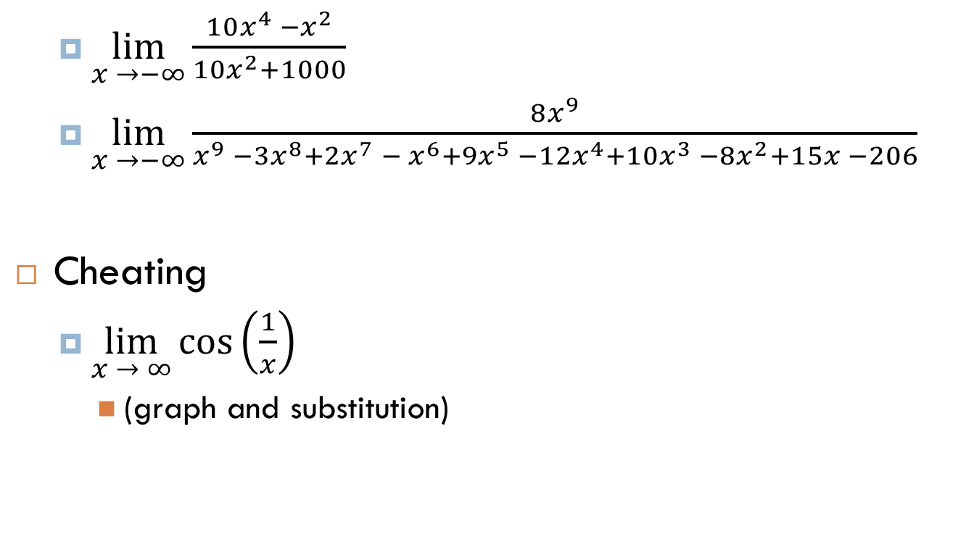
2.2 Limits Involving Infinity
  $\lim_{x →−∞}{\frac{10x^{4} −x^{2}}{{10x}^{2}+1000}}$
  $\lim_{x →−∞}{\frac{8x^{9}}{x^{9} −3x^{8}+2x^{7} − x^{6}+9x^{5} −12x^{4}+10x^{3} −8x^{2}+15x −206}}$
Cheating
  $\lim_{x → ∞}{\cos\left(\frac{1}{x}\right)}$
    (graph and substitution)

Slide 17
Limits at Infinity Project
Assignment:
  pg. 76 (1-65, 69, 70)
  Limits At Infinity Project: due the class after the Chapter 2 test

Slide 18
Continuity
2.3

Slide 19
2.3 Continuity
A very non-technical definition of continuity: A graph is continuous everywhere you don’t have to lift your pencil to draw the graph
A more technical definition of continuity: As x approaches a, the limit exists and is the same as the function value.
Sometimes, a graph can be said to be “continuous on its domain” despite having a discontinuity. (Now we’re skipping problems 31-40.)

Slide 20
2.3 Continuity
Types of discontinuities (pg. 80): removable (hole), jump, infinite, and oscillating (how to show with limits)

Slide 21
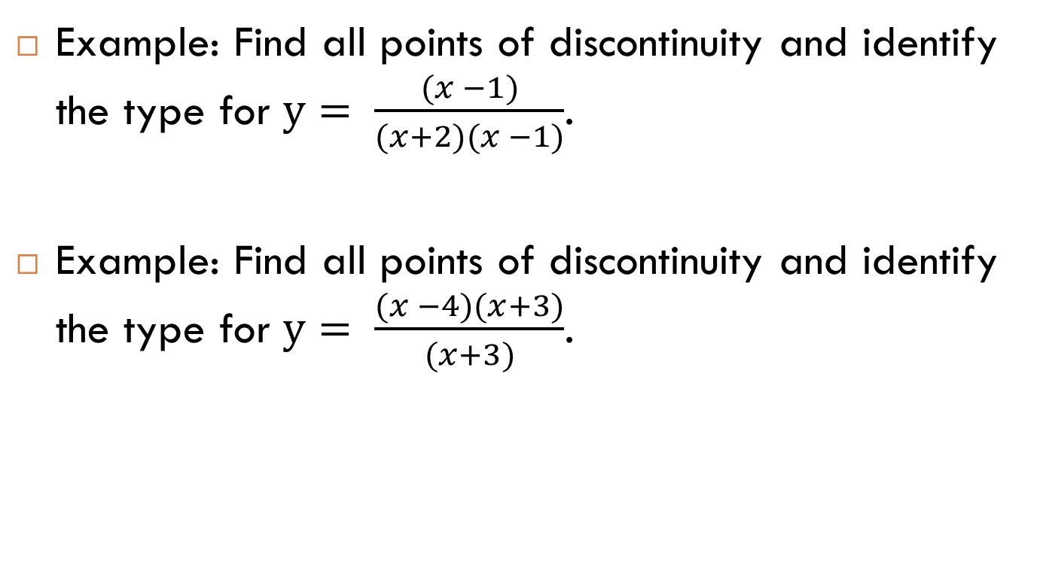
2.3 Continuity
Example: Find all points of discontinuity and identify the type for $y= \frac{(x −1)}{(x+2)(x −1)}$.
Example: Find all points of discontinuity and identify the type for $y= \frac{(x −4)(x+3)}{(x+3)}$.

Slide 22
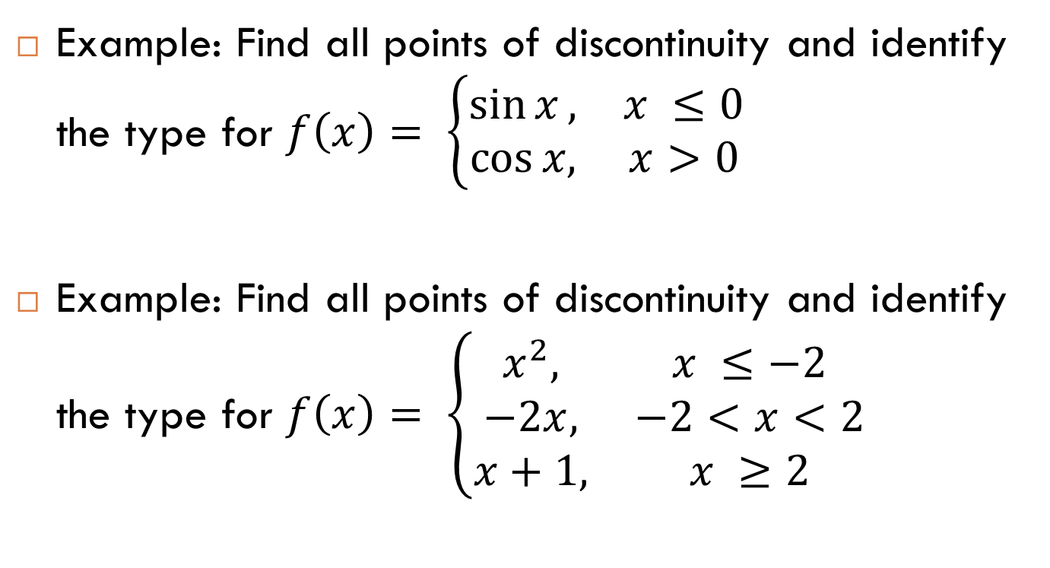
2.3 Continuity
Example: Find all points of discontinuity and identify the type for $f\left(x\right)= \left\{\begin{matrix}\sin{x}, & x ≤0 \\ \cos{x,} & x>0\end{matrix}\right.$
Example: Find all points of discontinuity and identify the type for $f\left(x\right)= \left\{\begin{matrix}x^{2}, & x ≤−2 \\ −2x, & −2<x<2 \\ x+1, & x ≥2\end{matrix}\right.$

Slide 23
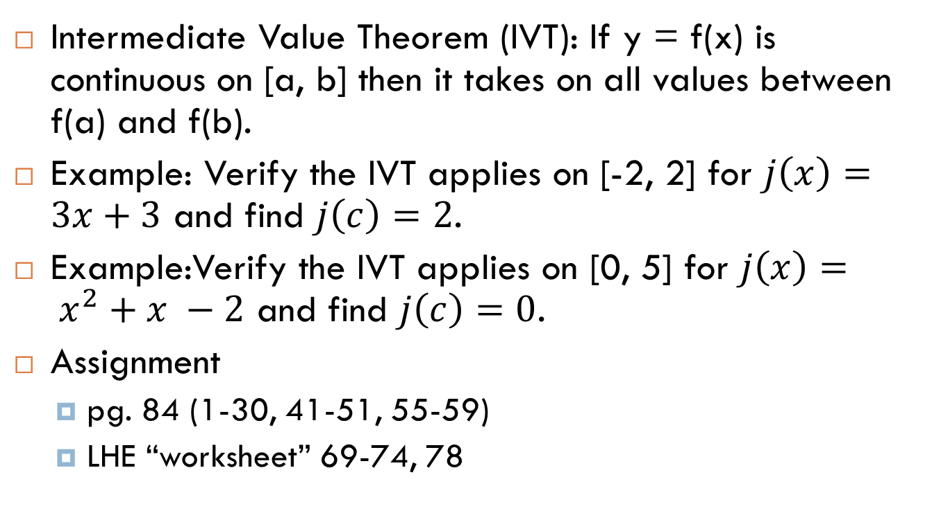
2.3 Continuity
Intermediate Value Theorem (IVT): If y = f(x) is continuous on [a, b] then it takes on all values between f(a) and f(b).
Example: Verify the IVT applies on [-2, 2] for $j\left(x\right)=3x+3$ and find $j\left(c\right)=2$.
Example:Verify the IVT applies on [0, 5] for $j\left(x\right)= x^{2}+x −2$ and find $j\left(c\right)=0$.
Assignment
  pg. 84 (1-30, 41-51, 55-59)
  LHE “worksheet” 69-74, 78

Slide 24
Rates of Change:
An Introduction to the Derivative
2.4

Slide 25
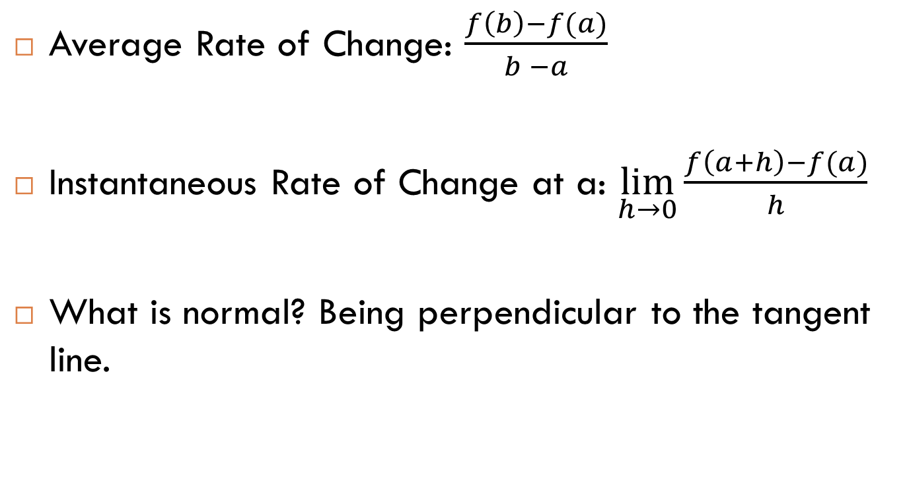
2.4 Rates of Change
Average Rate of Change: $\frac{f\left(b\right)−f(a)}{b −a}$
Instantaneous Rate of Change at a: $\lim_{h→0}{\frac{f\left(a+h\right)−f(a)}{h}}$
What is normal? Being perpendicular to the tangent line.

Slide 26
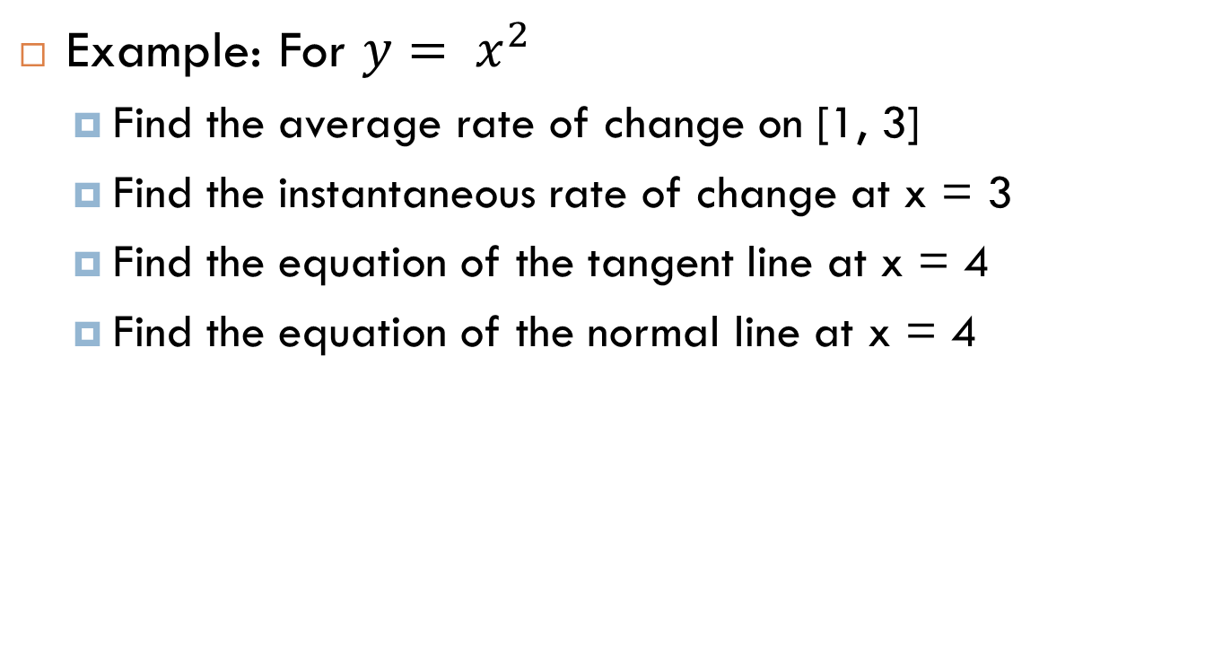
2.4 Rates of Change
Example: For $y= x^{2}$
  Find the average rate of change on [1, 3]
  Find the instantaneous rate of change at x = 3
  Find the equation of the tangent line at x = 4
  Find the equation of the normal line at x = 4

Slide 27

2.4 Rates of Change
Example: For $y= x^{3}$
  Find the average rate of change on [0, 3]
  Find the instantaneous rate of change at x = 2
  Find the equation of the tangent line at x = 3
  Find the equation of the normal line at x = 2

Slide 28
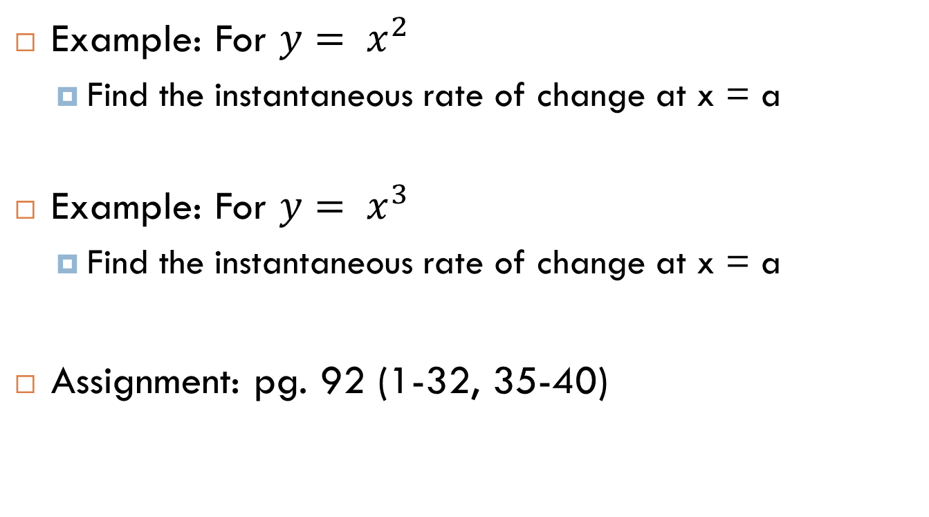
2.4 Rates of Change
Example: For $y= x^{2}$
  Find the instantaneous rate of change at x = a
Example: For $y= x^{3}$
  Find the instantaneous rate of change at x = a
Assignment: pg. 92 (1-32, 35-40)

