Slide 1
More Derivatives
(NO CALCULATOR TEST)
3.6-3.9

Slide 2
Chain Rule
3.6

Slide 3
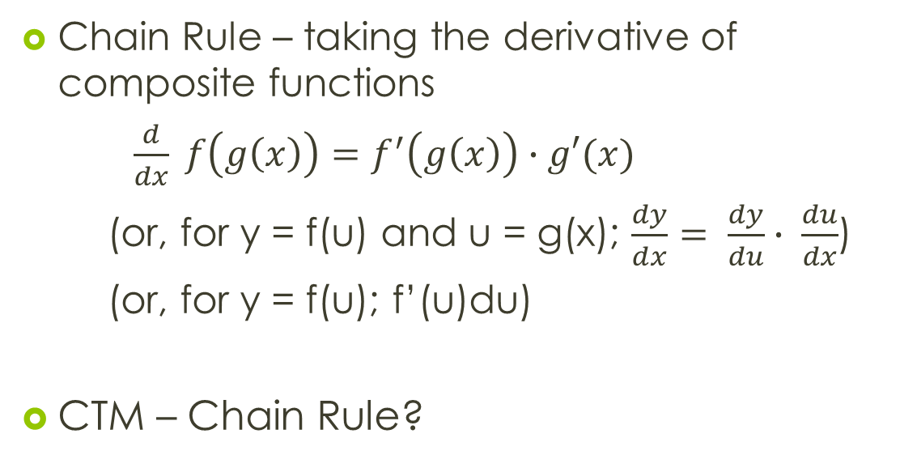
3.6 Chain Rule
Chain Rule – taking the derivative of composite functions
$\frac{d}{dx} f\left(g\left(x\right)\right)=f^{′}\left(g\left(x\right)\right)∙g′(x)$
(or, for y = f(u) and u = g(x); $\frac{dy}{dx}= \frac{dy}{du}∙ \frac{du}{dx}$)
(or, for y = f(u); f’(u)du)
CTM – Chain Rule?

Slide 4
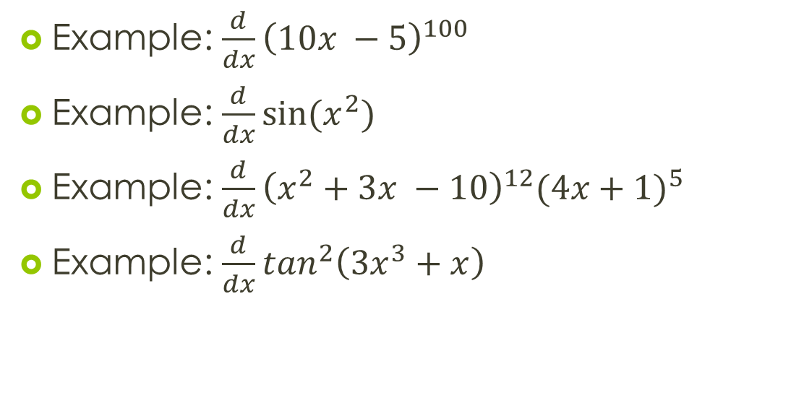
3.6 Chain Rule
Example: $\frac{d}{dx}{\left(10x −5\right)}^{100}$
Example: $\frac{d}{dx}\sin{(x^{2})}$
Example: $\frac{d}{dx}{\left(x^{2}+3x −10\right)}^{12}{(4x+1)}^{5}$
Example: $\frac{d}{dx}\tan^{2}\left(3x^{3}+x\right)$

Slide 5
3.6 Chain Rule
Example: Find an expression for the velocity, acceleration, and jerk for a particle whose position is given by:
  s(t) = sin 2t (easy)
  s(t) = csc t (interesting)
Assignment: pg. 153 (1-40, 53-63, 70, 72, 73)

Slide 6
Implicit Differentiation
3.7

Slide 7
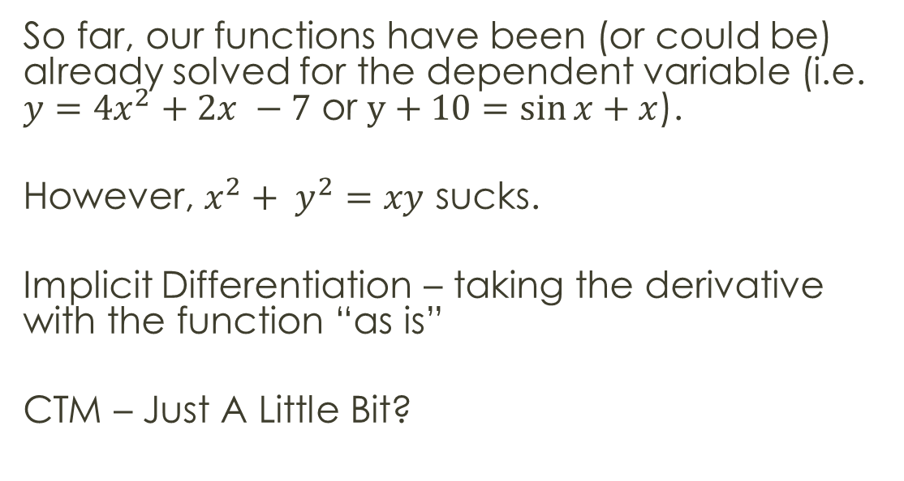
3.7 Implicit Differentiation
So far, our functions have been (or could be) already solved for the dependent variable (i.e. $y=4x^{2}+2x −7$ or $y+10=\sin{x}+x$).
However, $x^{2}+ y^{2}=xy$ sucks.
Implicit Differentiation – taking the derivative with the function “as is”
CTM – Just A Little Bit?

Slide 8
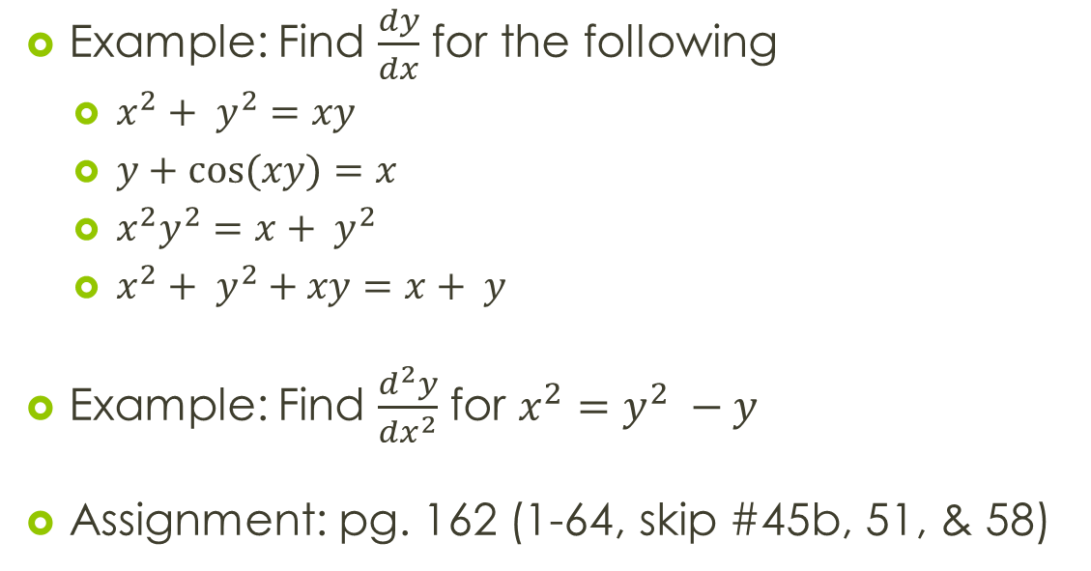
3.7 Implicit Differentiation
Example: Find $\frac{dy}{dx}$ for the following
  $x^{2}+ y^{2}=xy$
  $y+\cos{(xy)}=x$
  $x^{2}y^{2}=x+ y^{2}$
  $x^{2}+ y^{2}+xy=x+ y$
Example: Find $\frac{d^{2}y}{dx^{2}}$ for $x^{2}=y^{2} −y$
Assignment: pg. 162 (1-64, skip #45b, 51, & 58)

Slide 9
Derivatives of Inverse Trigonometry Functions
3.8

Slide 10
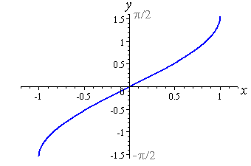
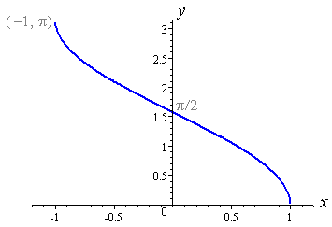
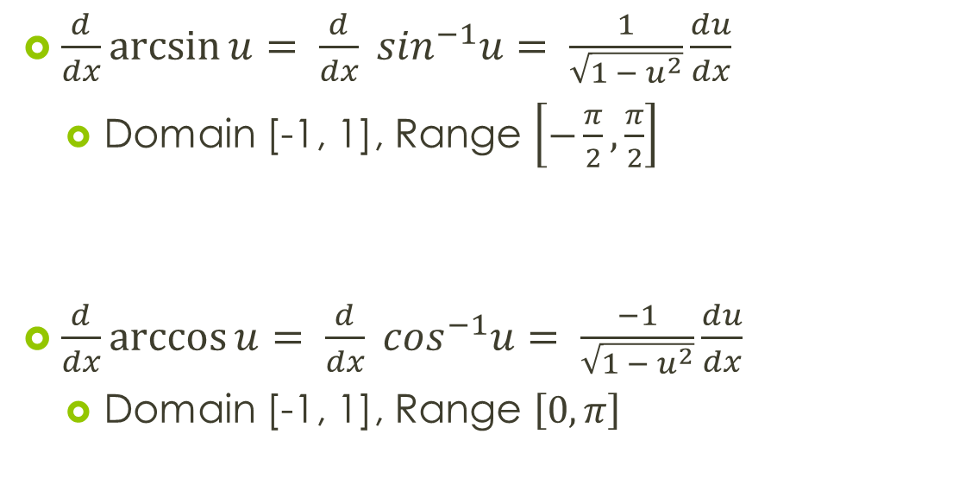
3.8 Derivatives of Inverse Trig
$\frac{d}{dx}\arcsin{u}= \frac{d}{dx} \sin^{−1}u= \frac{1}{\sqrt{1 − u^{2}}}\frac{du}{dx}$
  Domain [-1, 1], Range $\left[−\frac{π}{2}, \frac{π}{2}\right]$
$\frac{d}{dx}\arccos{u}= \frac{d}{dx} \cos^{−1}u= \frac{−1}{\sqrt{1 − u^{2}}}\frac{du}{dx}$
  Domain [-1, 1], Range $\left[0, π\right]$

Slide 11
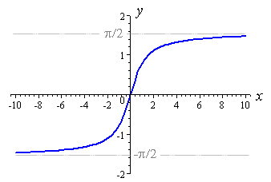
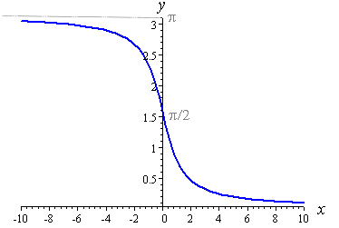
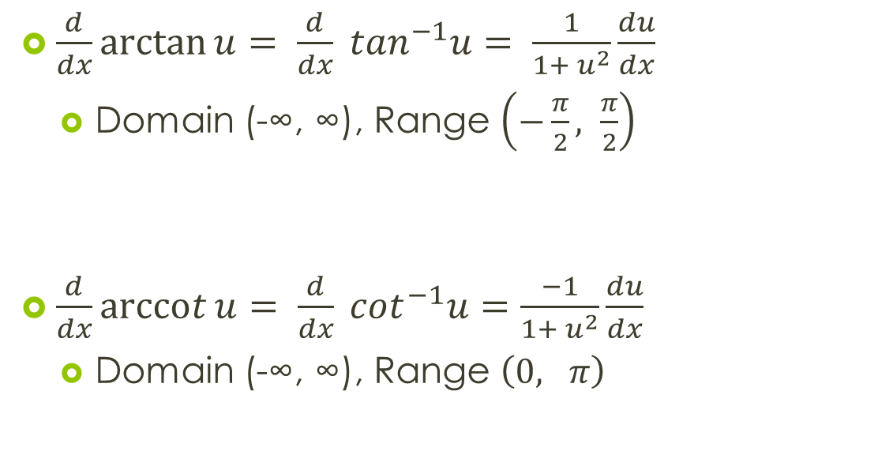
3.8 Derivatives of Inverse Trig
$\frac{d}{dx}\arctan{u}= \frac{d}{dx} \tan^{−1}u= \frac{1}{1+ u^{2}}\frac{du}{dx}$
  Domain (-∞, ∞), Range $\left(−\frac{π}{2}, \frac{π}{2}\right)$
$\frac{d}{dx}\operatorname{arccot}{u}= \frac{d}{dx} \cot^{−1}u=\frac{−1}{1+ u^{2}}\frac{du}{dx}$
  Domain (-∞, ∞), Range $\left(0, π\right)$

Slide 12
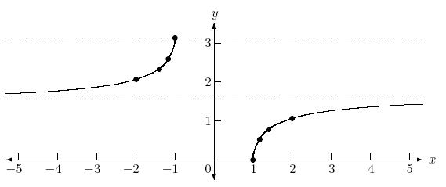
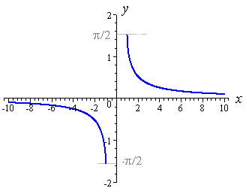
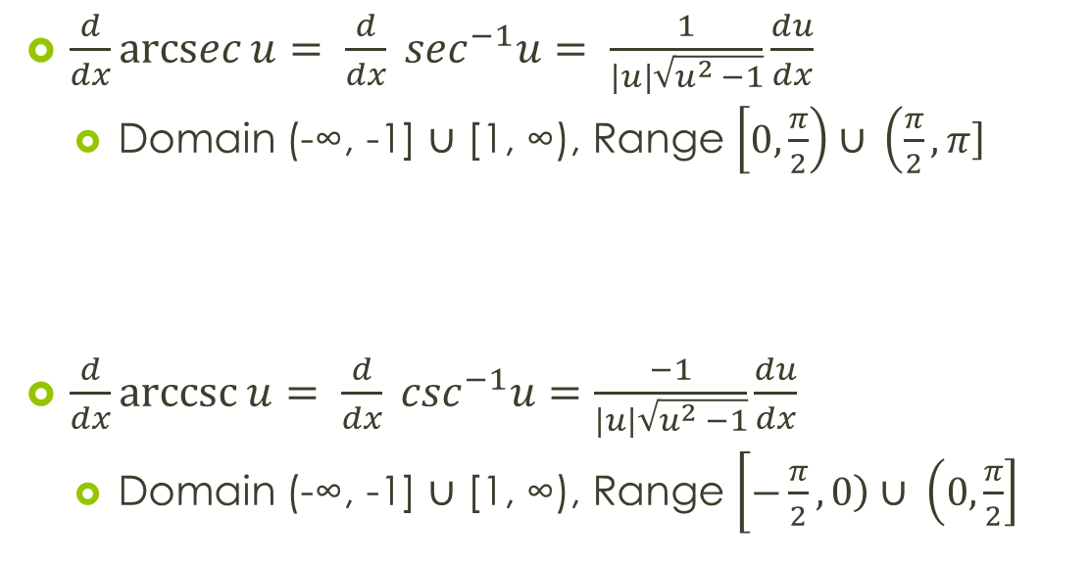
3.8 Derivatives of Inverse Trig
$\frac{d}{dx}\operatorname{arcsec}{u}= \frac{d}{dx} \sec^{−1}u= \frac{1}{\left|u\right|\sqrt{u^{2} −1}}\frac{du}{dx}$
  Domain (-∞, -1] $∪$ [1, ∞), Range $\left[0, \left.\frac{π}{2}\right)\right.∪ \left(\frac{π}{2}, \left.π\right]\right.$
$\frac{d}{dx}\operatorname{arccsc}{u}= \frac{d}{dx} \csc^{−1}u=\frac{−1}{\left|u\right|\sqrt{u^{2} −1}}\frac{du}{dx}$
  Domain (-∞, -1] $∪$ [1, ∞), Range $\left[−\frac{π}{2}, \left.0\right)∪ \left(0, \left.\frac{π}{2}\right]\right.\right.$

Slide 13

3.8 Derivatives of Inverse Trig
Example: $\frac{d}{dx} \sin^{−1} (x+1)$
Example: $\frac{d}{dt}\operatorname{arcsec}{{(t}^{2})}$
Example: $\frac{d}{ds} \tan^{−1} \left(\frac{1}{s}\right)$

Slide 14
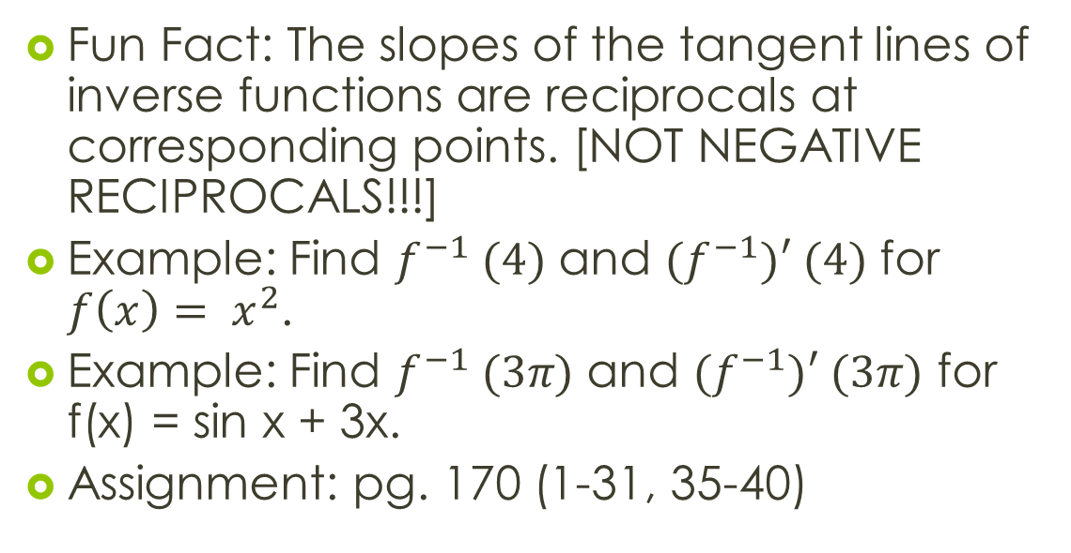
3.8 Derivatives of Inverse Trig
Fun Fact: The slopes of the tangent lines of inverse functions are reciprocals at corresponding points. [NOT NEGATIVE RECIPROCALS!!!]
Example: Find $f^{−1} (4)$ and ${(f}^{−1})′ (4)$ for $f\left(x\right)= x^{2}$.
Example: Find $f^{−1} (3π)$ and ${(f}^{−1})′ (3π)$ for f(x) = sin x + 3x.
Assignment: pg. 170 (1-31, 35-40)

Slide 15
Derivatives of Exponential and Logarithmic Functions
3.9

Slide 16
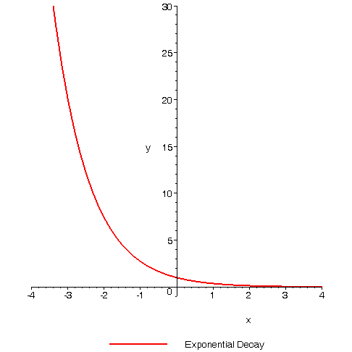
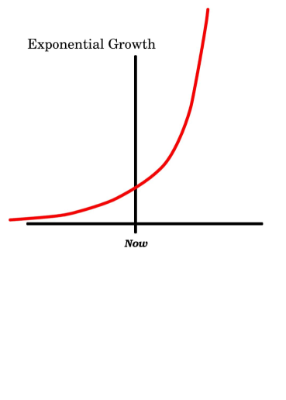
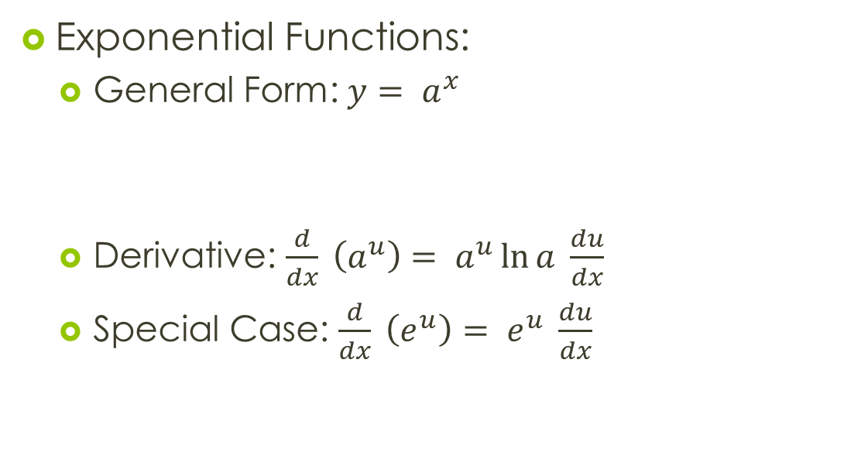
3.9 Derivatives of
Exponential Functions
Exponential Functions:
  General Form: $y= a^{x}$
  Derivative: $\frac{d}{dx} \left(a^{u}\right)= a^{u}\ln{a} \frac{du}{dx}$
  Special Case: $\frac{d}{dx} \left(e^{u}\right)= e^{u} \frac{du}{dx}$

Slide 17

3.9 Derivatives of
Exponential Functions
Example: $\frac{d}{dx} 2^{x}$
Example: $\frac{d}{dx} e^{x^{2}}$
Example: $\frac{d}{dx} 2^{x^{2}}$

Slide 18
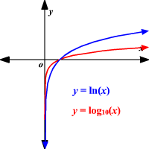
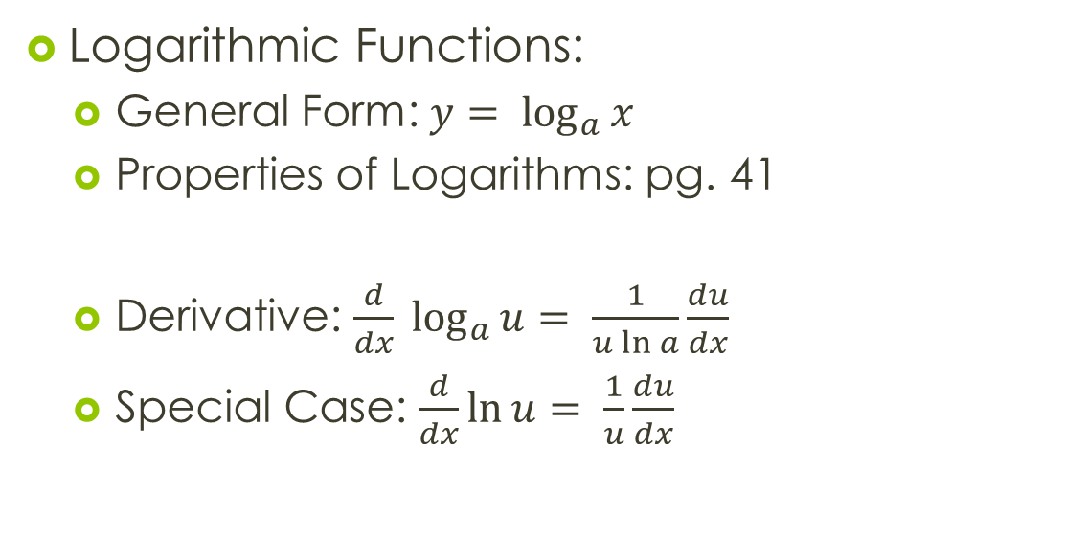
3.9 Derivatives of
Logarithmic Functions
Logarithmic Functions:
  General Form: $y= \log_{a}{x}$
  Properties of Logarithms: pg. 41
  Derivative: $\frac{d}{dx} \log_{a}{u}= \frac{1}{u\ln{a}}\frac{du}{dx}$
  Special Case: $\frac{d}{dx}\ln{u}= \frac{1}{u}\frac{du}{dx}$

Slide 19
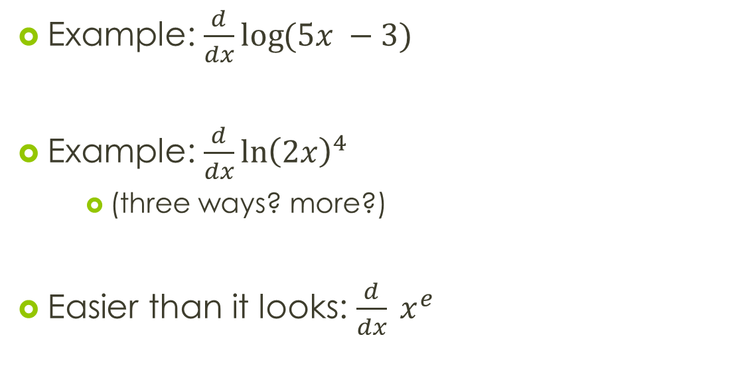
3.9 Derivatives of
Logarithmic Functions
Example: $\frac{d}{dx}\log{(5x −3)}$
Example: $\frac{d}{dx}\ln{{\left(2x\right)}^{4}}$
    (three ways? more?)
Easier than it looks: $\frac{d}{dx} x^{e}$

Slide 20
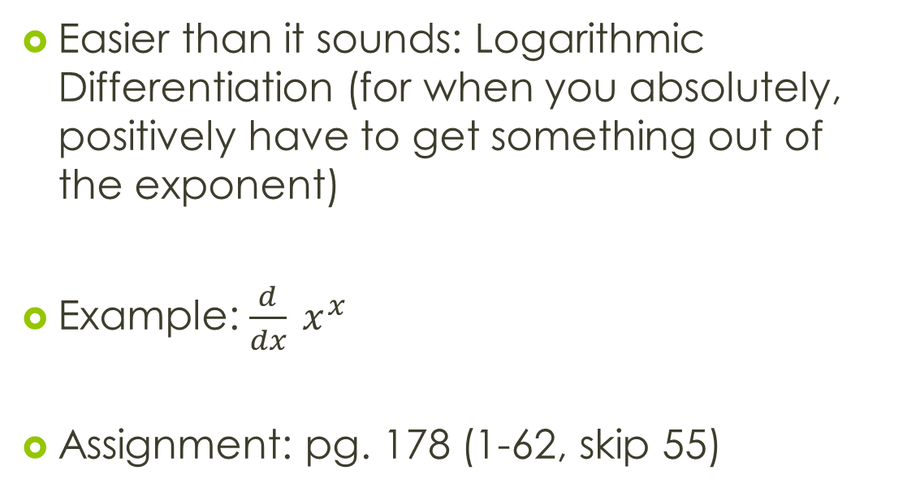
3.9 Derivatives of
Logarithmic Functions
Easier than it sounds: Logarithmic Differentiation (for when you absolutely, positively have to get something out of the exponent)
Example: $\frac{d}{dx} x^{x}$
Assignment: pg. 178 (1-62, skip 55)

Slide 21
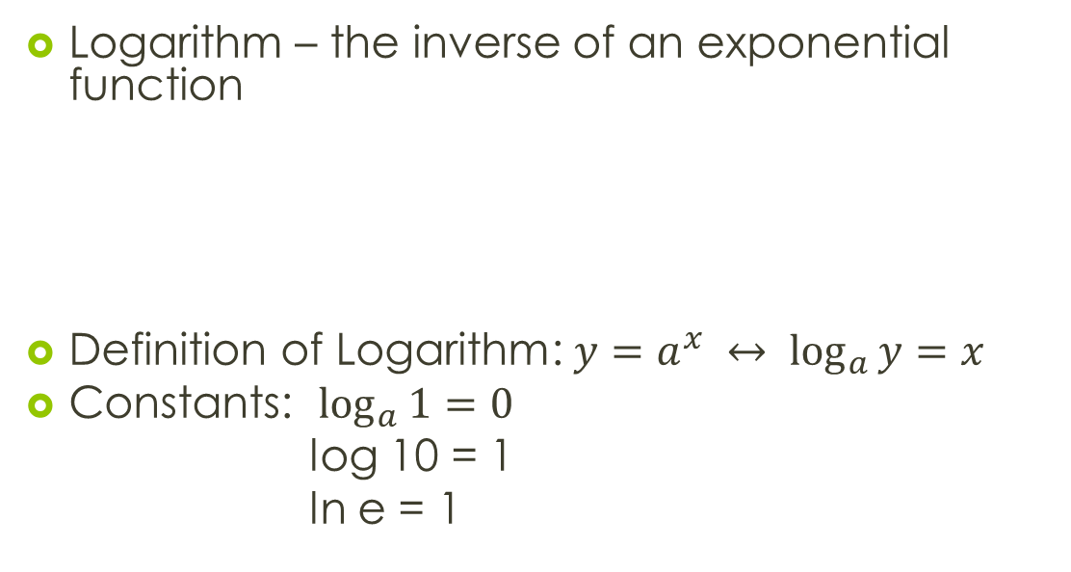
Logarithms Review
Logarithm – the inverse of an exponential function
Definition of Logarithm: $y=a^{x} ↔ \log_{a}{y}=x$
Constants: $\log_{a}{1}=0$
log 10 = 1
ln e = 1

Slide 22
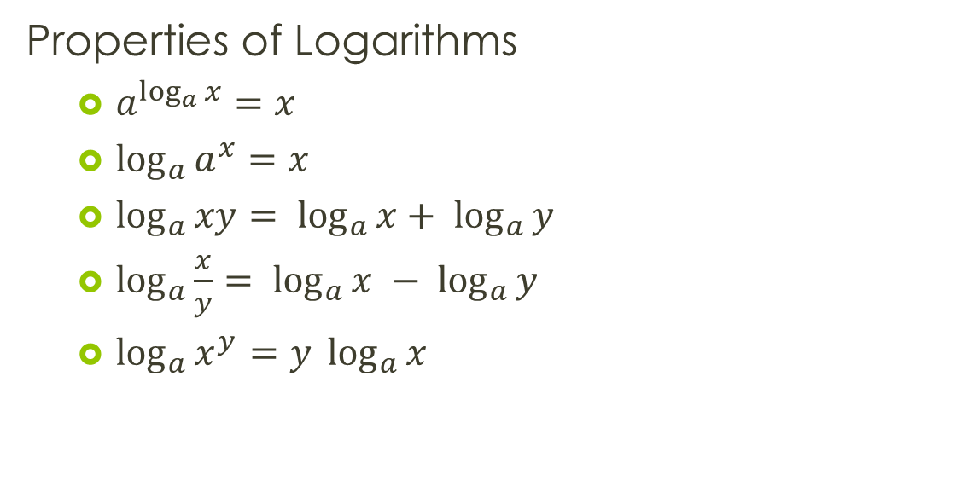
Logarithms Review
Properties of Logarithms
  $a^{\log_{a}{x}}=x$
  $\log_{a}{a^{x}}=x$
  $\log_{a}{xy= \log_{a}{x}+ \log_{a}{y}}$
  $\log_{a}{\frac{x}{y}= \log_{a}{x} − \log_{a}{y}}$
  $\log_{a}{x^{y}=y \log_{a}{x}}$

