Slide 1
Series
NO CALCULATOR TEST
Chapter 9

Slide 2
Power Series
9.1

Slide 3
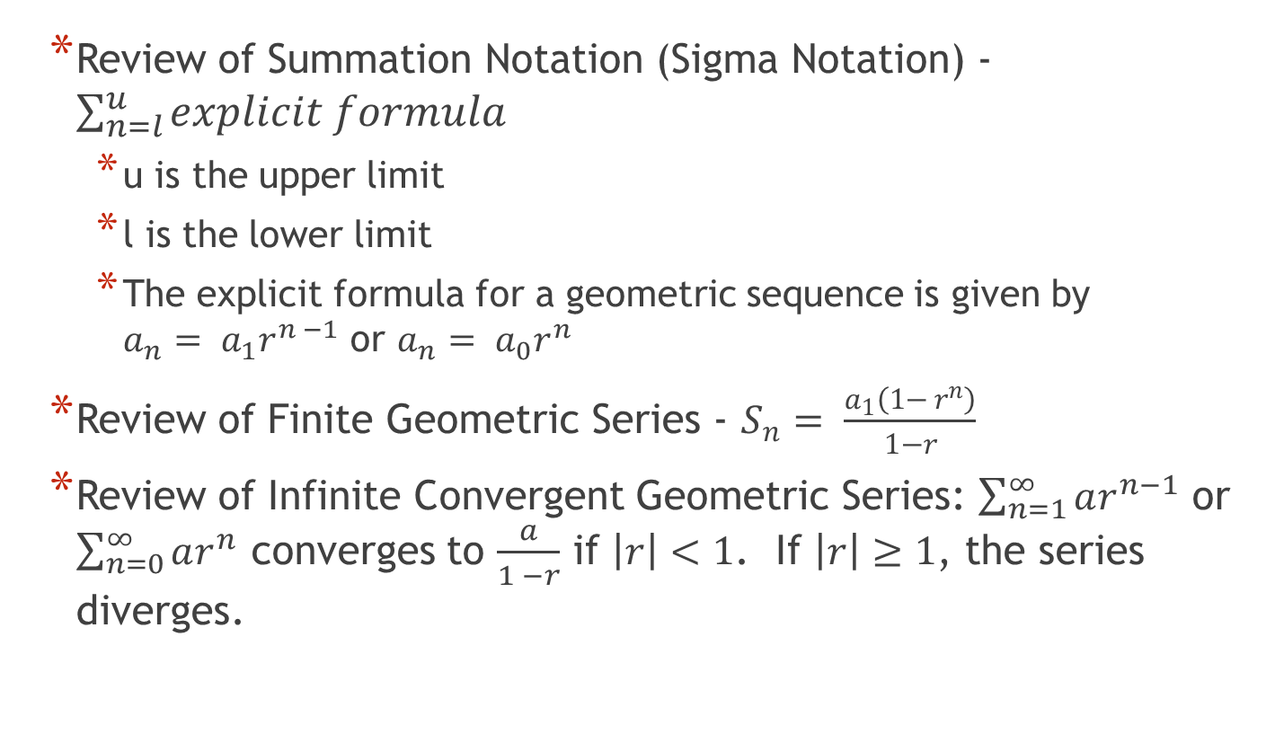
9.1 Power Series
Review of Summation Notation (Sigma Notation) - $\sum_{n=l}^{u}{explicit formula}$
  u is the upper limit
  l is the lower limit
  The explicit formula for a geometric sequence is given by $a_{n}= a_{1}r^{n −1}$ or $a_{n}= a_{0}r^{n}$
Review of Finite Geometric Series - $S_{n}= \frac{a_{1}\left(1− r^{n}\right)}{1−r}$
Review of Infinite Convergent Geometric Series: $\sum_{n=1}^{∞}{ar^{n−1}}$ or $\sum_{n=0}^{∞}{ar^{n}}$ converges to $\frac{a}{1 −r}$ if $\left|r\right|<1$. If $\left|r\right|≥1$, the series diverges.

Slide 4
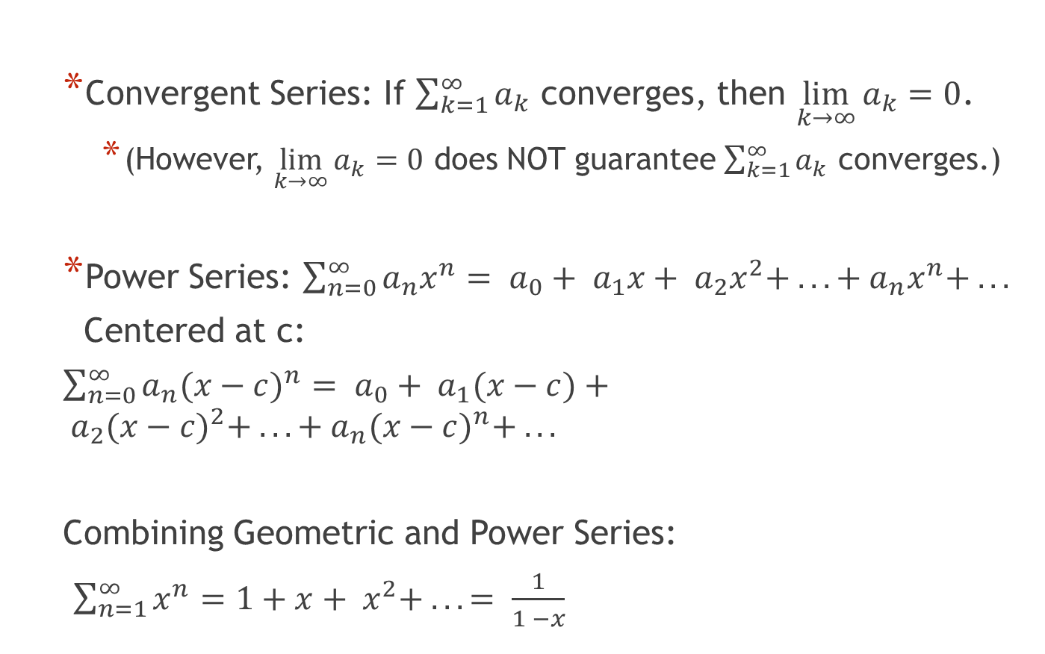
9.1 Power Series
Convergent Series: If $\sum_{k=1}^{∞}{a_{k}}$ converges, then $\lim_{k→∞}{a_{k}=0}$.
  (However, $\lim_{k→∞}{a_{k}=0}$ does NOT guarantee $\sum_{k=1}^{∞}{a_{k}}$ converges.)
Power Series: $\sum_{n=0}^{∞}{a_{n}x^{n}}= a_{0}+ a_{1}x+ a_{2}x^{2}+ . . . + a_{n}x^{n}+ . . .$
Centered at c:
$\sum_{n=0}^{∞}{a_{n}{(x−c)}^{n}}= a_{0}+ a_{1}(x−c)+ a_{2}({x−c)}^{2}+ . . . + a_{n}({x−c)}^{n}+ . . .$
Combining Geometric and Power Series:
$\sum_{n=1}^{∞}{x^{n}}=1+x+ x^{2}+ . .. = \frac{1}{1 −x}$

Slide 5
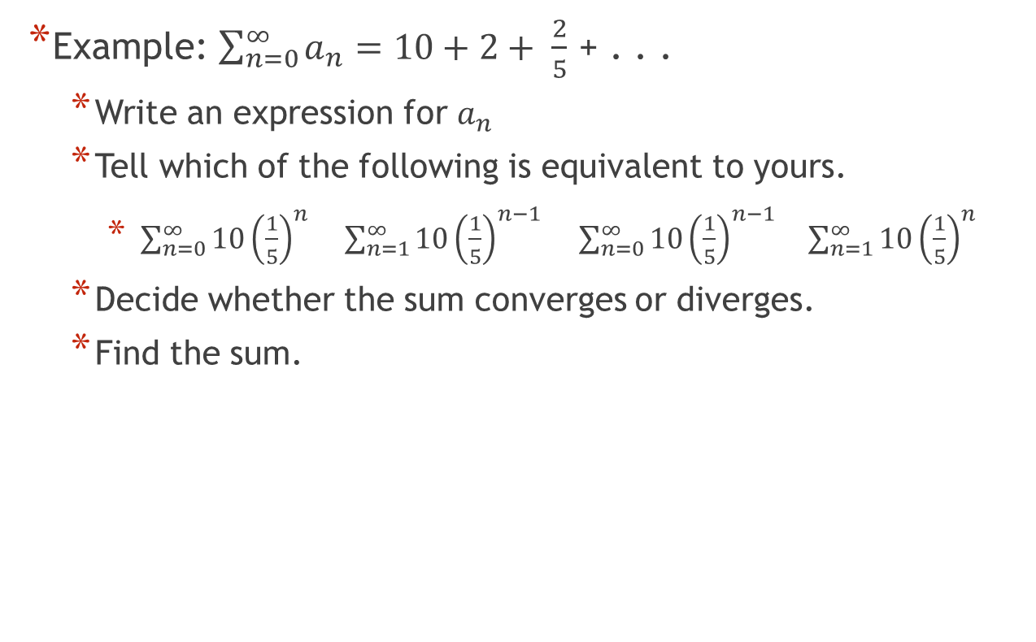
9.1 Power Series
Example: $\sum_{n=0}^{∞}{a_{n}=10+2+ \frac{2}{5}}$ + . . .
  Write an expression for $a_{n}$
  Tell which of the following is equivalent to yours.
    $\sum_{n=0}^{∞}{10{\left(\frac{1}{5}\right)}^{n}}$ $\sum_{n=1}^{∞}{10{\left(\frac{1}{5}\right)}^{n−1}}$ $\sum_{n=0}^{∞}{10{\left(\frac{1}{5}\right)}^{n−1}} \sum_{n=1}^{∞}{10{\left(\frac{1}{5}\right)}^{n}}$
  Decide whether the sum converges or diverges.
  Find the sum.

Slide 6
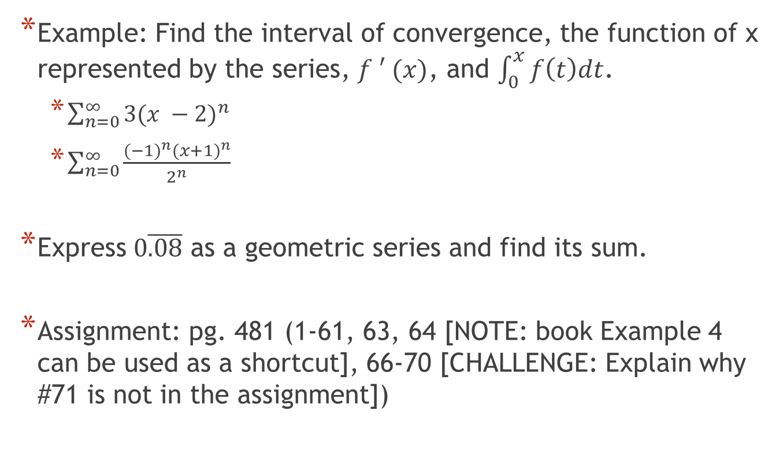
9.1 Power Series
Example: Find the interval of convergence, the function of x represented by the series, $f ′ (x)$, and $\int_{0}^{x}{f\left(t\right)dt}$.
  $\sum_{n=0}^{∞}{3{(x −2)}^{n}}$
  $\sum_{n=0}^{∞}{\frac{{(−1)}^{n}{(x+1)}^{n}}{2^{n}}}$
Express $0\overline{.08}$ as a geometric series and find its sum.
Assignment: pg. 481 (1-61, 63, 64 [NOTE: book Example 4 can be used as a shortcut], 66-70 [CHALLENGE: Explain why #71 is not in the assignment])

Slide 7
Taylor Polynomials
9.2

Slide 8
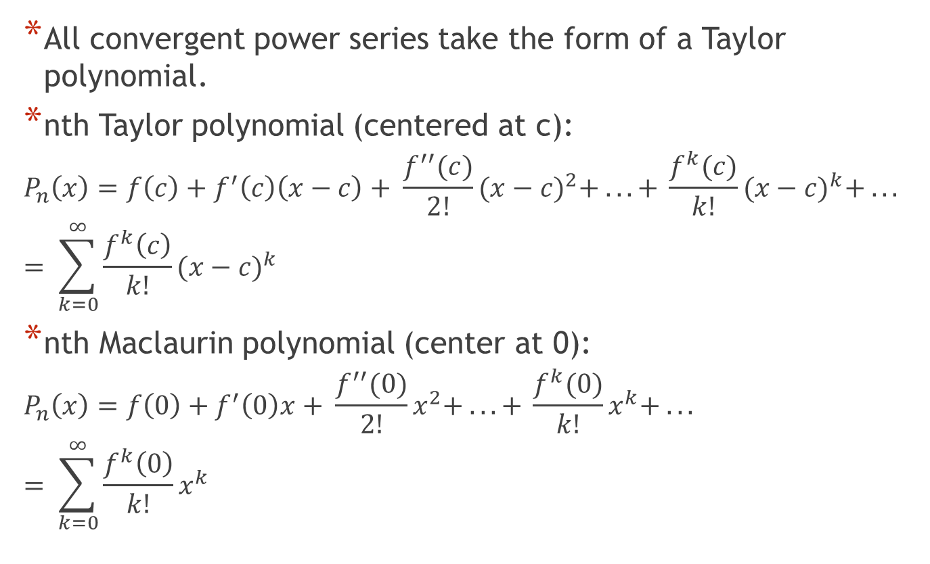
9.2 Taylor Polynomials
All convergent power series take the form of a Taylor polynomial.
nth Taylor polynomial (centered at c):
$$P_{n}\left(x\right)=f\left(c\right)+f^{′}\left(c\right)\left(x−c\right)+ \frac{f^{′′}(c)}{2!}{(x−c)}^{2}+ . . . + \frac{f^{k}(c)}{k!}{(x−c)}^{k}+ . . .$$
$$= \sum_{k=0}^{∞}{\frac{f^{k}\left(c\right)}{k!}{(x−c)}^{k}}$$
nth Maclaurin polynomial (center at 0):
$$P_{n}\left(x\right)=f\left(0\right)+f^{′}\left(0\right)x+ \frac{f^{′′}(0)}{2!}x^{2}+ . . . + \frac{f^{k}(0)}{k!}x^{k}+ . . .$$
$$= \sum_{k=0}^{∞}{\frac{f^{k}\left(0\right)}{k!}x^{k}}$$

Slide 9
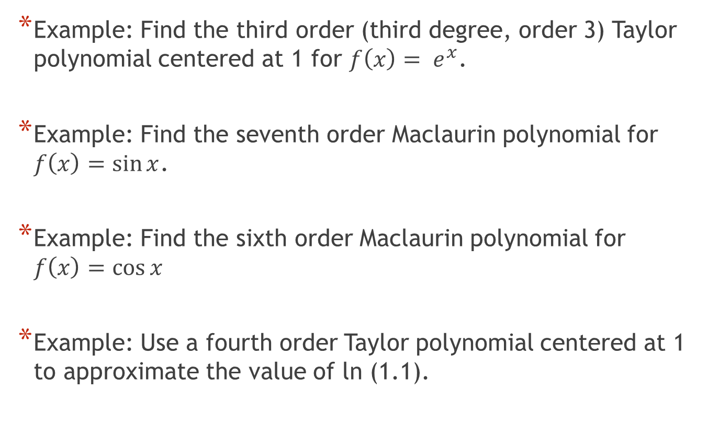
9.2 Taylor Polynomials
Example: Find the third order (third degree, order 3) Taylor polynomial centered at 1 for $f\left(x\right)= e^{x}$.
Example: Find the seventh order Maclaurin polynomial for $f\left(x\right)=\sin{x}$.
Example: Find the sixth order Maclaurin polynomial for $f\left(x\right)=\cos{x}$
Example: Use a fourth order Taylor polynomial centered at 1 to approximate the value of ln (1.1).

Slide 10
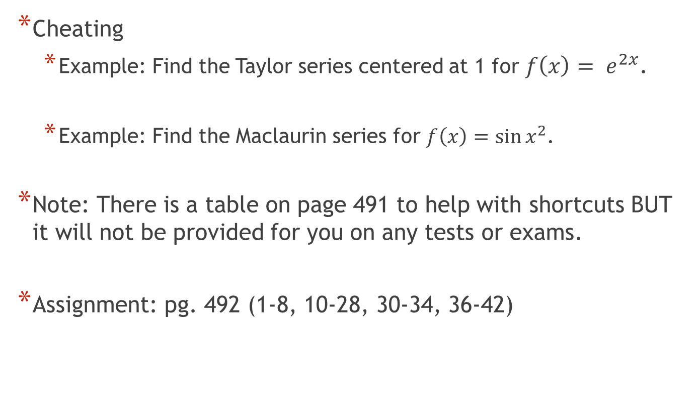
9.2 Taylor Polynomials
Cheating
  Example: Find the Taylor series centered at 1 for $f\left(x\right)= e^{2x}$.
  Example: Find the Maclaurin series for $f\left(x\right)=\sin{x^{2}}$.
Note: There is a table on page 491 to help with shortcuts BUT it will not be provided for you on any tests or exams.
Assignment: pg. 492 (1-8, 10-28, 30-34, 36-42)

Slide 11
Taylor’s Theorem
9.3

Slide 12
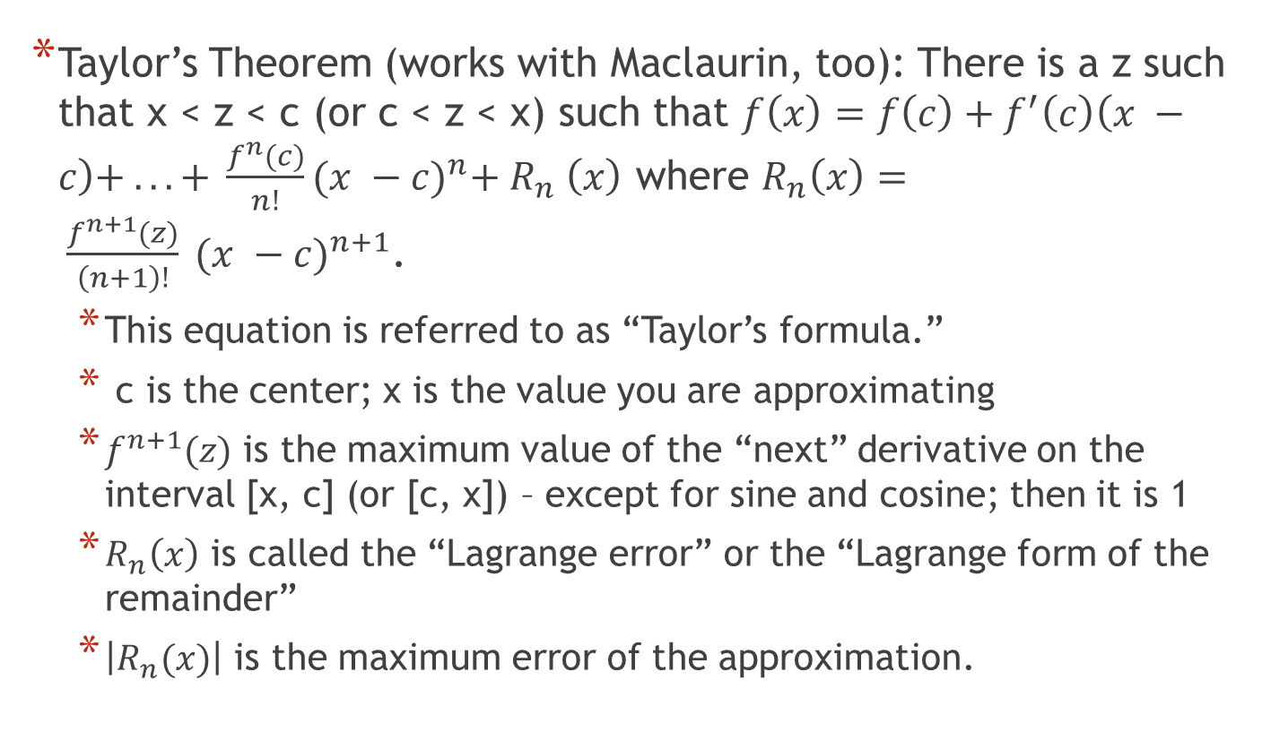
9.3 Taylor’s Theorem
Taylor’s Theorem (works with Maclaurin, too): There is a z such that x < z < c (or c < z < x) such that $f\left(x\right)=f\left(c\right)+f^{′}\left(c\right)\left(x −c\right)+ . . . + \frac{f^{n}(c)}{n!}{(x −c)}^{n}+ R_{n} \left(x\right)$ where $R_{n}\left(x\right)= \frac{f^{n+1}(z)}{\left(n+1\right)!} {(x −c)}^{n+1}$.
  This equation is referred to as “Taylor’s formula.”
  c is the center; x is the value you are approximating
  $f^{n+1}(z)$ is the maximum value of the “next” derivative on the interval [x, c] (or [c, x]) – except for sine and cosine; then it is 1
  $R_{n}\left(x\right)$ is called the “Lagrange error” or the “Lagrange form of the remainder”
  $\left|R_{n}(x)\right|$ is the maximum error of the approximation.

Slide 13
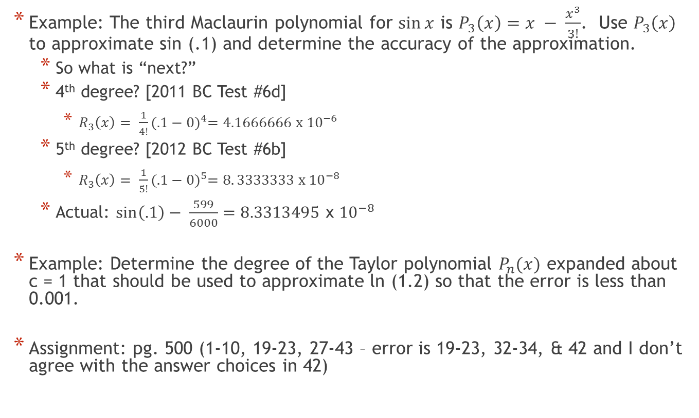
9.3 Taylor’s Theorem
Example: The third Maclaurin polynomial for $\sin{x}$ is $P_{3}\left(x\right)=x − \frac{x^{3}}{3!}$. Use $P_{3}\left(x\right)$ to approximate sin (.1) and determine the accuracy of the approximation.
  So what is “next?”
  4th degree? [2011 BC Test #6d]
    $R_{3}\left(x\right)= \frac{1}{4!}{(.1−0)}^{4}=4.1666666 x {10}^{−6}$
  5th degree? [2012 BC Test #6b]
    $R_{3}\left(x\right)= \frac{1}{5!}{(.1−0)}^{5}=8. 3333333 x {10}^{−8}$
  Actual: $\sin\left(.1\right)− \frac{599}{6000}=8.3313495$ x ${10}^{−8}$
Example: Determine the degree of the Taylor polynomial $P_{n}(x)$ expanded about c = 1 that should be used to approximate ln (1.2) so that the error is less than 0.001.
Assignment: pg. 500 (1-10, 19-23, 27-43 – error is 19-23, 32-34, & 42 and I don’t agree with the answer choices in 42)

Slide 14
Convergence Tests
(and Radius of Convergence)
9.4

Slide 15
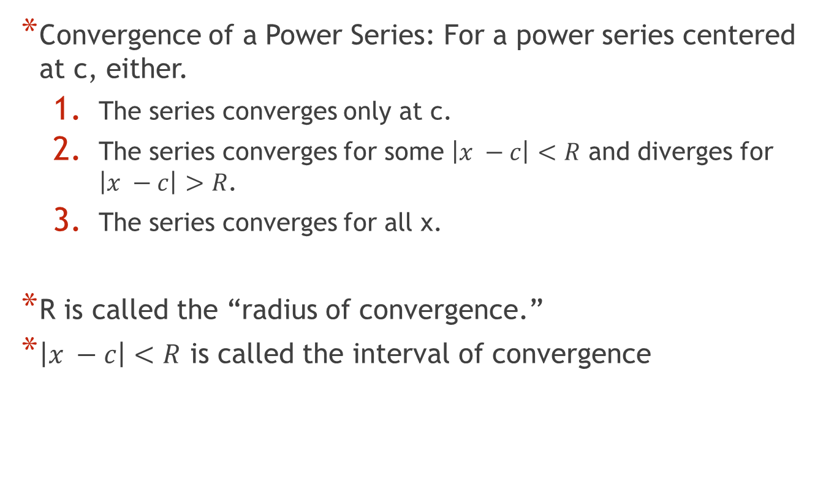
9.4 Convergence Tests
Convergence of a Power Series: For a power series centered at c, either.
  The series converges only at c.
  The series converges for some $\left|x −c\right|<R$ and diverges for $\left|x −c\right|>R$.
  The series converges for all x.
R is called the “radius of convergence.”
$\left|x −c\right|<R$ is called the interval of convergence

Slide 16
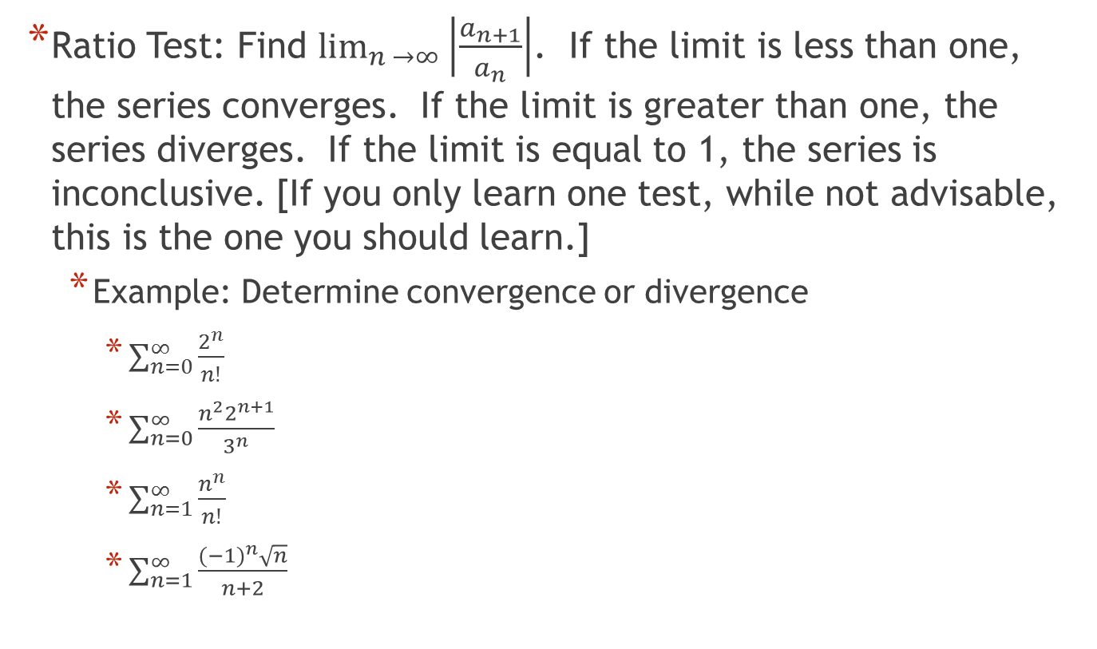
9.4 Convergence Tests
Ratio Test: Find $\lim_{n →∞}\left|\frac{a_{n+1}}{a_{n}}\right|$. If the limit is less than one, the series converges. If the limit is greater than one, the series diverges. If the limit is equal to 1, the series is inconclusive. [If you only learn one test, while not advisable, this is the one you should learn.]
  Example: Determine convergence or divergence
    $\sum_{n=0}^{∞}{\frac{2^{n}}{n!}}$
    $\sum_{n=0}^{∞}{\frac{n^{2}2^{n+1}}{3^{n}}}$
    $\sum_{n=1}^{∞}{\frac{n^{n}}{n!}}$
    $\sum_{n=1}^{∞}{\frac{{(−1)}^{n}\sqrt{n}}{n+2}}$

Slide 17
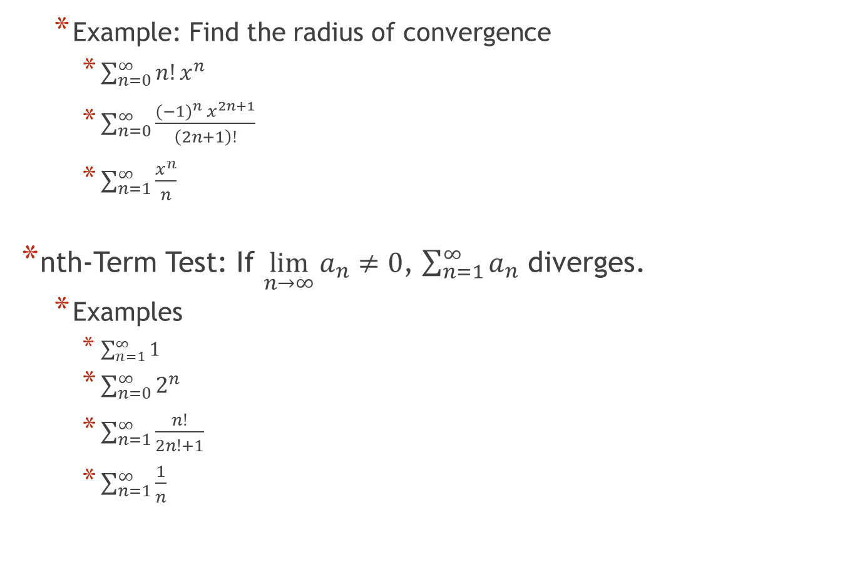
9.4 Convergence Tests
  Example: Find the radius of convergence
    $\sum_{n=0}^{∞}{n!x^{n}}$
    $\sum_{n=0}^{∞}{\frac{{(−1)}^{n} x^{2n+1}}{\left(2n+1\right)!}}$
    $\sum_{n=1}^{∞}{\frac{x^{n}}{n}}$
nth-Term Test: If $\lim_{n→∞}{a_{n}≠0}$, $\sum_{n=1}^{∞}{a_{n}}$ diverges.
  Examples
    $\sum_{n=1}^{∞}{1}$
    $\sum_{n=0}^{∞}{2^{n}}$
    $\sum_{n=1}^{∞}{\frac{n!}{2n!+1}}$
    $\sum_{n=1}^{∞}{\frac{1}{n}}$

Slide 18
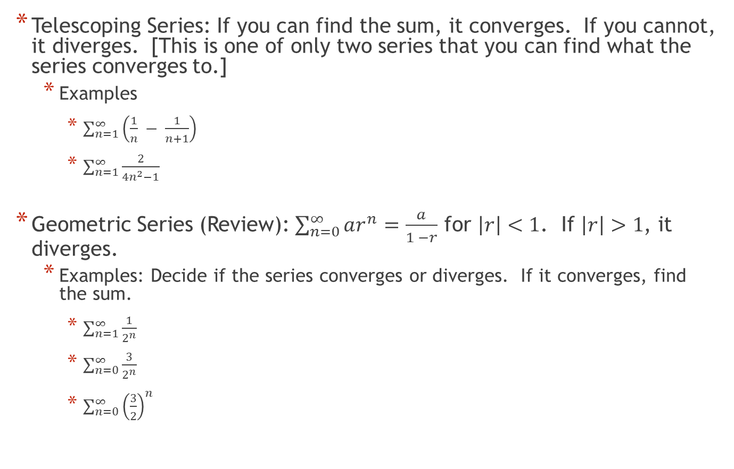
9.4 Convergence Tests
Telescoping Series: If you can find the sum, it converges. If you cannot, it diverges. [This is one of only two series that you can find what the series converges to.]
  Examples
    $\sum_{n=1}^{∞}{\left(\frac{1}{n} − \frac{1}{n+1}\right)}$
    $\sum_{n=1}^{∞}{\frac{2}{4n^{2}−1}}$
Geometric Series (Review): $\sum_{n=0}^{∞}{ar^{n}}=\frac{a}{1 −r}$ for $\left|r\right|<1$. If $\left|r\right|>1$, it diverges.
  Examples: Decide if the series converges or diverges. If it converges, find the sum.
    $\sum_{n=1}^{∞}{\frac{1}{2^{n}}}$
    $\sum_{n=0}^{∞}{\frac{3}{2^{n}}}$
    $\sum_{n=0}^{∞}{{\left(\frac{3}{2}\right)}^{n}}$

Slide 19
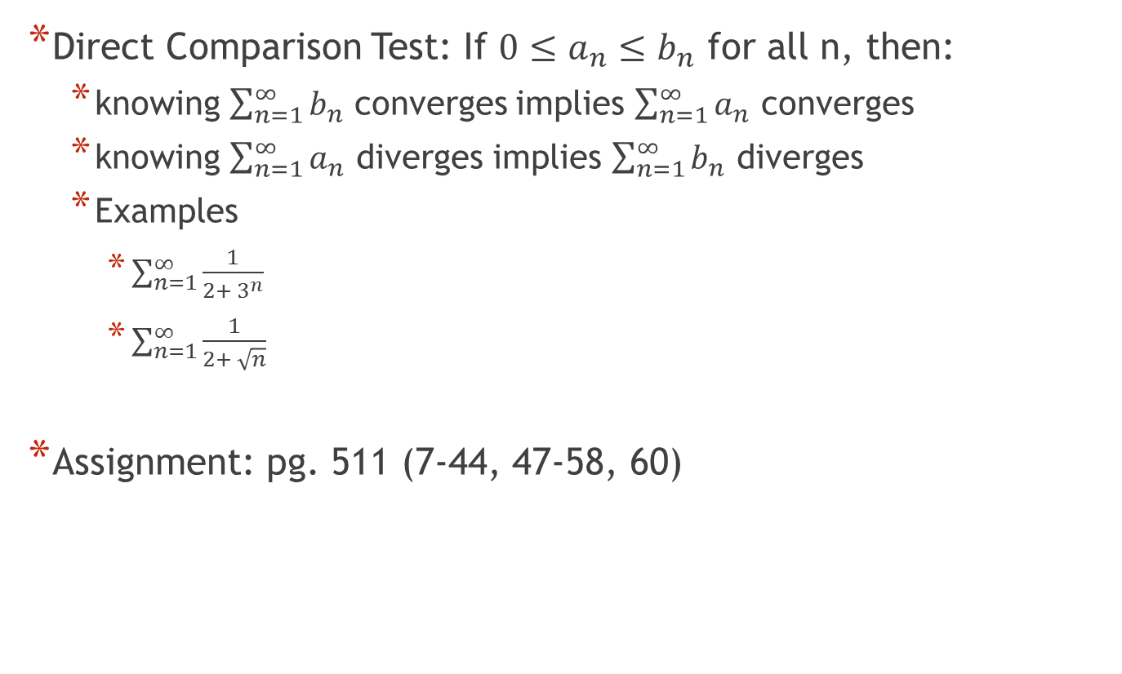
9.4 Convergence Tests
Direct Comparison Test: If $0≤a_{n}≤b_{n}$ for all n, then:
  knowing $\sum_{n=1}^{∞}{b_{n}}$ converges implies $\sum_{n=1}^{∞}{a_{n}}$ converges
  knowing $\sum_{n=1}^{∞}{a_{n}}$ diverges implies $\sum_{n=1}^{∞}{b_{n}}$ diverges
  Examples
    $\sum_{n=1}^{∞}{\frac{1}{2+ 3^{n}}}$
    $\sum_{n=1}^{∞}{\frac{1}{2+ \sqrt{n}}}$
Assignment: pg. 511 (7-44, 47-58, 60)

Slide 20
More Convergence Tests
(and Interval of Convergence)
9.5

Slide 21

9.5 Convergence Tests
p-series: $\sum_{n=1}^{∞}{\frac{1}{n^{p}}}= \frac{1}{1^{p}}+\frac{1}{2^{p}}+\frac{1}{3^{p}}+ . . .$
  $p>1$ converges
  $p ≤1$ diverges
  Examples
    $\sum_{n=1}^{∞}{\frac{1}{n}}$ [Note: this series with p = 1 is called the “harmonic series”]
    $\sum_{n=1}^{∞}{\frac{1}{n^{2}}}$
    $\sum_{n=1}^{∞}{\frac{1}{\sqrt[3]{n}}}$

Slide 22
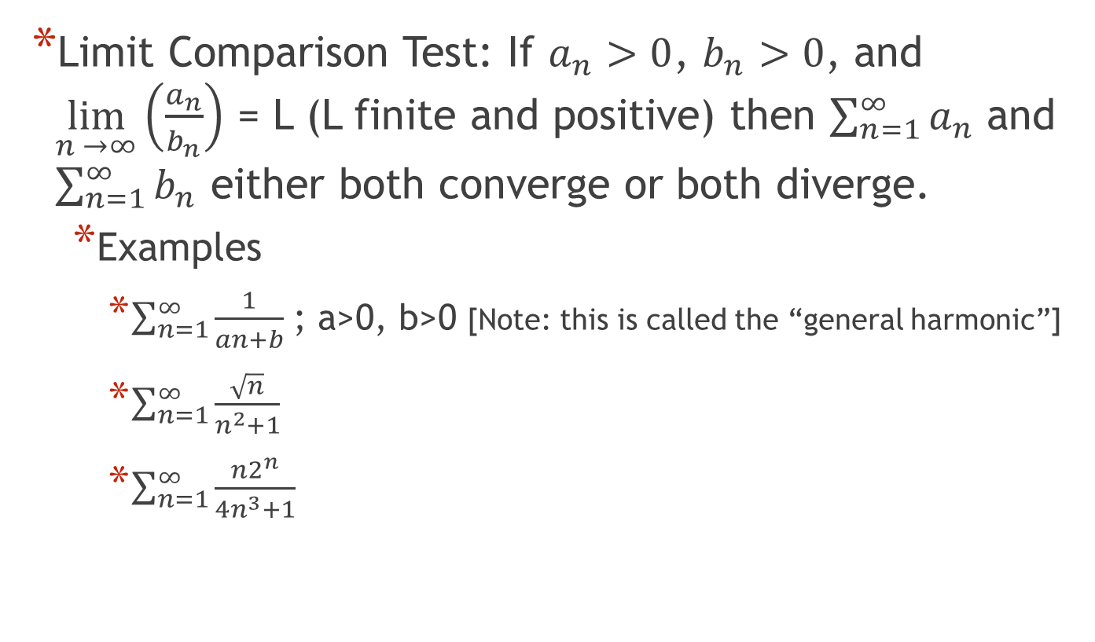
9.5 Convergence Tests
Limit Comparison Test: If $a_{n}>0$, $b_{n}>0$, and $\lim_{n →∞}\left(\frac{a_{n}}{b_{n}}\right)$ = L (L finite and positive) then $\sum_{n=1}^{∞}{a_{n}}$ and $\sum_{n=1}^{∞}{b_{n}}$ either both converge or both diverge.
  Examples
    $\sum_{n=1}^{∞}{\frac{1}{an+b}}$ ; a>0, b>0 [Note: this is called the “general harmonic”]
    $\sum_{n=1}^{∞}{\frac{\sqrt{n}}{n^{2}+1}}$
    $\sum_{n=1}^{∞}{\frac{n2^{n}}{4n^{3}+1}}$

Slide 23
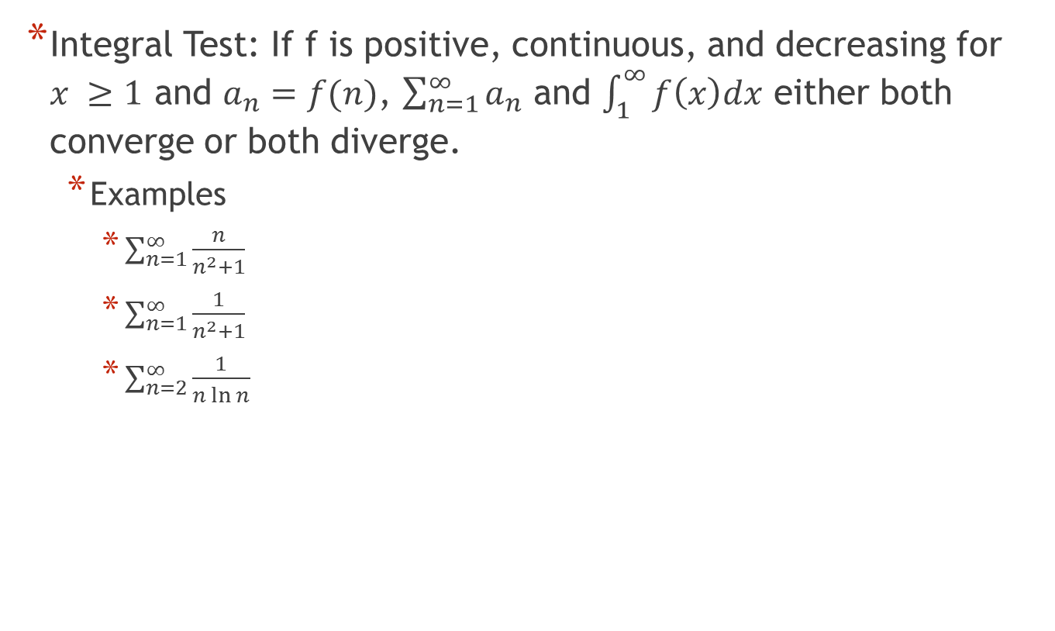
9.5 Convergence Tests
Integral Test: If f is positive, continuous, and decreasing for $x ≥1$ and $a_{n}=f(n)$, $\sum_{n=1}^{∞}{a_{n}}$ and $\int_{1}^{∞}{f\left(x\right)dx}$ either both converge or both diverge.
  Examples
    $\sum_{n=1}^{∞}{\frac{n}{n^{2}+1}}$
    $\sum_{n=1}^{∞}{\frac{1}{n^{2}+1}}$
    $\sum_{n=2}^{∞}{\frac{1}{n\ln{n}}}$

Slide 24
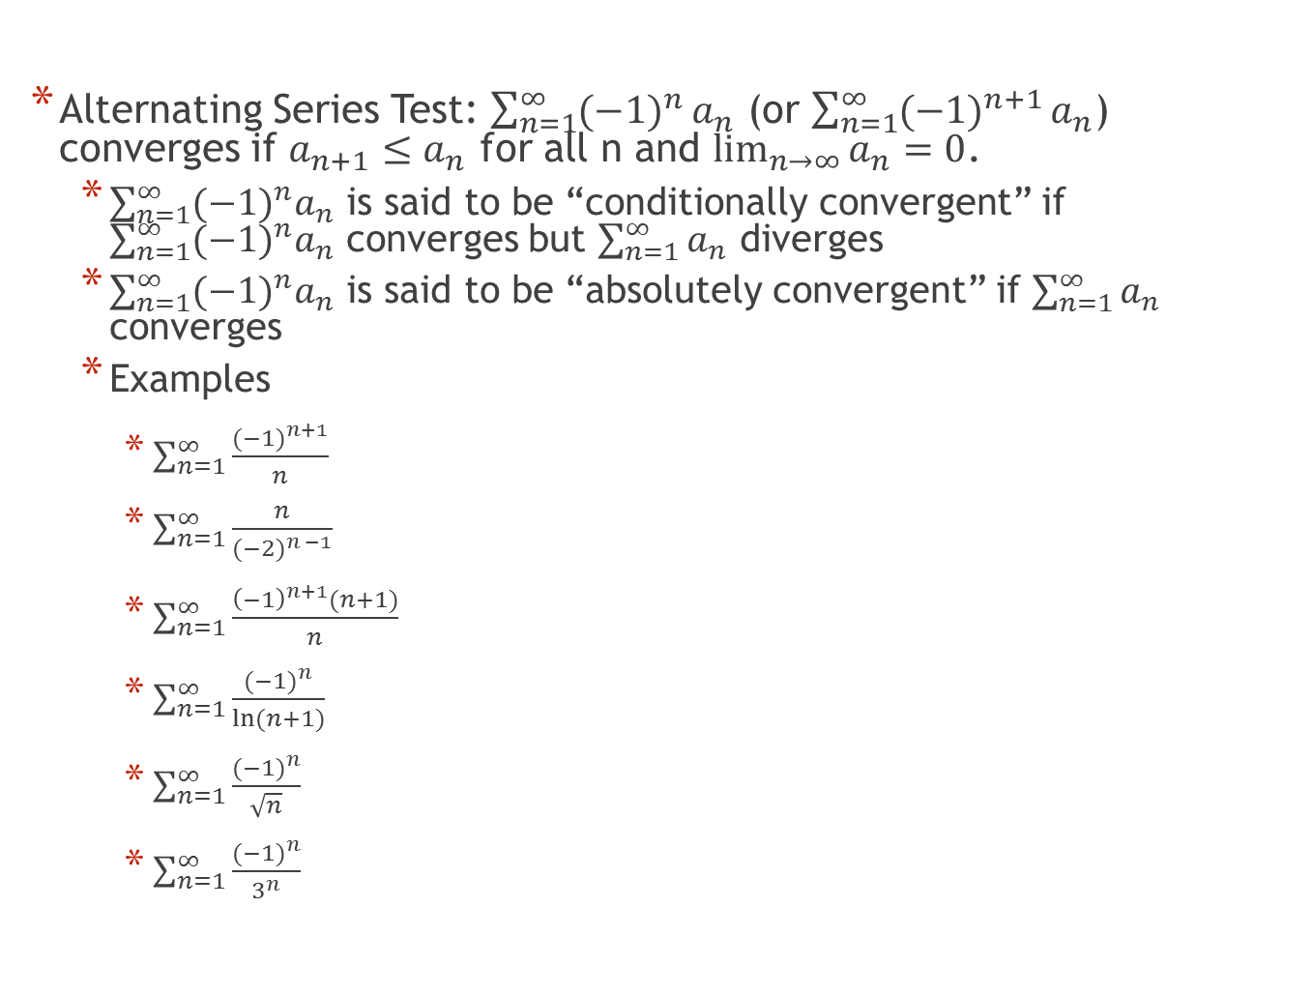
9.5 Convergence Tests
Alternating Series Test: $\sum_{n=1}^{∞}{{(−1)}^{n}}a_{n}$ (or $\sum_{n=1}^{∞}{{(−1)}^{n+1}}a_{n}$) converges if $a_{n+1}≤a_{n}$ for all n and $\lim_{n→∞}{a_{n}=0}$.
  $\sum_{n=1}^{∞}{{{(−1)}^{n}a}_{n}}$ is said to be “conditionally convergent” if $\sum_{n=1}^{∞}{{{(−1)}^{n}a}_{n}}$ converges but $\sum_{n=1}^{∞}{a_{n}}$ diverges
  $\sum_{n=1}^{∞}{{{(−1)}^{n}a}_{n}}$ is said to be “absolutely convergent” if $\sum_{n=1}^{∞}{a_{n}}$ converges
  Examples
    $\sum_{n=1}^{∞}{\frac{{(−1)}^{n+1}}{n}}$
    $\sum_{n=1}^{∞}{\frac{n}{{(−2)}^{n −1}}}$
    $\sum_{n=1}^{∞}{\frac{{\left(−1\right)}^{n+1}(n+1)}{n}}$
    $\sum_{n=1}^{∞}{\frac{{(−1)}^{n}}{\ln{(n+1)}}}$
    $\sum_{n=1}^{∞}{\frac{{(−1)}^{n}}{\sqrt{n}}}$
    $\sum_{n=1}^{∞}{\frac{{(−1)}^{n}}{3^{n}}}$

Slide 25
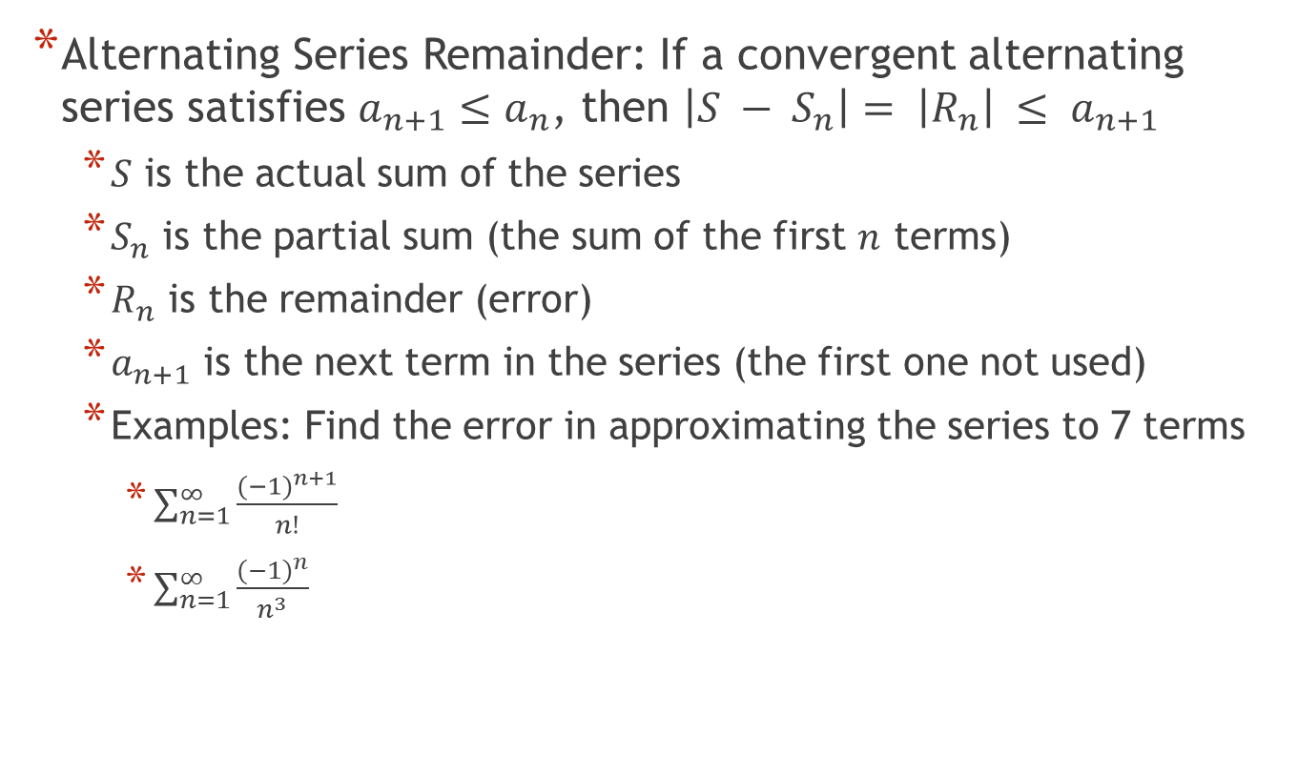
9.5 Convergence Tests
Alternating Series Remainder: If a convergent alternating series satisfies $a_{n+1}≤a_{n}$, then $\left|S − S_{n}\right|= \left|R_{n}\right| ≤ a_{n+1}$
  $S$ is the actual sum of the series
  $S_{n}$ is the partial sum (the sum of the first $n$ terms)
  $R_{n}$ is the remainder (error)
  $a_{n+1}$ is the next term in the series (the first one not used)
  Examples: Find the error in approximating the series to 7 terms
    $\sum_{n=1}^{∞}{\frac{{(−1)}^{n+1}}{n!}}$
    $\sum_{n=1}^{∞}{\frac{{(−1)}^{n}}{n^{3}}}$

Slide 26
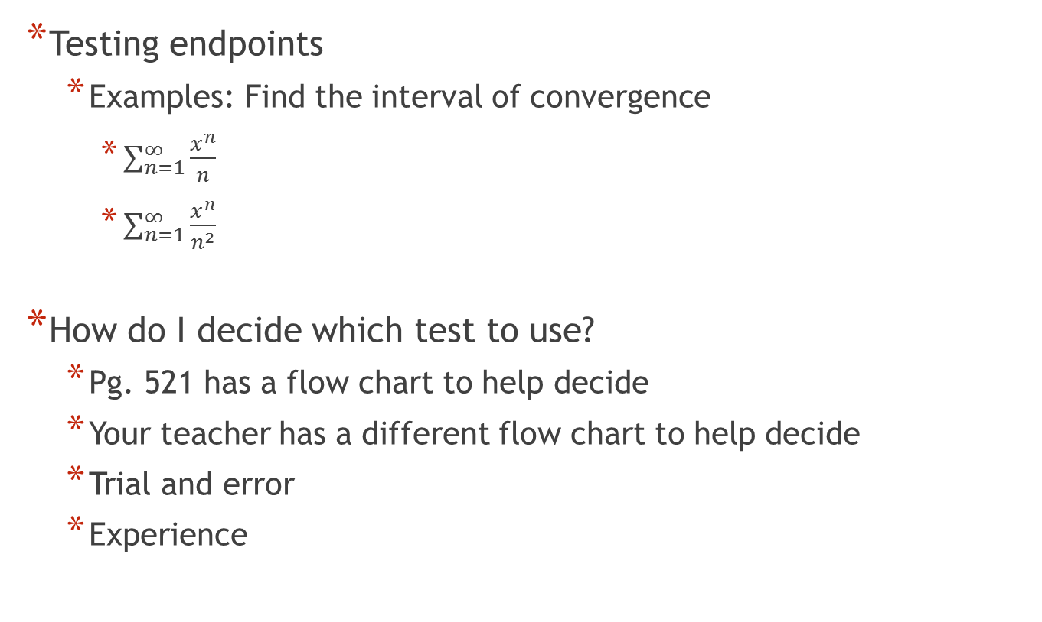
9.5 Convergence Tests
Testing endpoints
  Examples: Find the interval of convergence
    $\sum_{n=1}^{∞}{\frac{x^{n}}{n}}$
    $\sum_{n=1}^{∞}{\frac{x^{n}}{n^{2}}}$
How do I decide which test to use?
  Pg. 521 has a flow chart to help decide
  Your teacher has a different flow chart to help decide
  Trial and error
  Experience

Slide 27
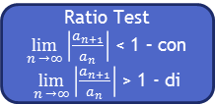
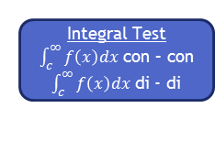
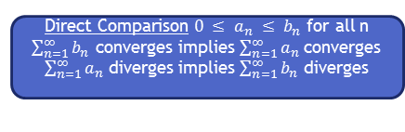
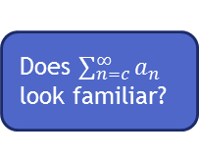


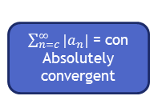

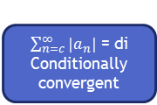
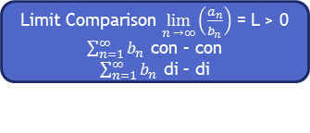
Does $\sum_{n=c}^{∞}{a_{n}}$ look familiar?
yes
no
Identify series type
nth-Term Test
$$\lim_{n→∞}{a_{n}} ≠0$$
$$\lim_{n→∞}{a_{n}}=0$$
Telescoping
Find sum – con
Cannot find - di
Geometric
|r| < 1 – con
|r|> 1 – di
p-series
p > 1 – con
p ≤ 1 - di
diverges
Is it an alternating series?
$\sum_{n=c}^{∞}{{|a}_{n}|}$ = con
Absolutely convergent
no
yes
Is it an easy integral?
Alternating Series Test
$0< a_{n+1}<a_{n}$ - con
cannot show – di
no
yes
Does it look like a series?
Integral Test
$\int_{c}^{∞}{f\left(x\right)dx}$ con – con
$\int_{c}^{∞}{f\left(x\right)dx}$ di - di
$\sum_{n=c}^{∞}{{|a}_{n}|}$ = di
Conditionally convergent
no
yes
Is it easy to make a finite limit?
Direct Comparison $0 ≤ a_{n} ≤ b_{n}$ for all n
$\sum_{n=1}^{∞}{b_{n}}$ converges implies $\sum_{n=1}^{∞}{a_{n}}$ converges
  $\sum_{n=1}^{∞}{a_{n}}$ diverges implies $\sum_{n=1}^{∞}{b_{n}}$ diverges
no
yes
Ratio Test
$\lim_{n →∞}\left|\frac{a_{n+1}}{a_{n}}\right|$ < 1 – con
$\lim_{n →∞}\left|\frac{a_{n+1}}{a_{n}}\right|$ > 1 - di
Limit Comparison $\lim_{n →∞}\left(\frac{a_{n}}{b_{n}}\right)$ = L > 0
$\sum_{n=1}^{∞}{b_{n}}$ con – con
$\sum_{n=1}^{∞}{b_{n}}$ di – di

Slide 28

9.5 Convergence Tests
Examples:
  $\sum_{n=1}^{∞}{\frac{n+1}{3n+1}}$
  $\sum_{n=1}^{∞}{{\left(\frac{π}{6}\right)}^{n}}$
  $\sum_{n=1}^{∞}{ne^{−n^{2}}}$
  $\sum_{n=1}^{∞}{\frac{1}{3n+1}}$
  $\sum_{n=1}^{∞}{\frac{{(−1)}^{n}3}{4n+1}}$
  $\sum_{n=1}^{∞}{\frac{n!}{{10}^{n}}}$
Assignment: pg. 523 (1-32, 35-51, 54, 58-71)
Notes:
a) diverges by nth-term test b) converges by geometric r < 1 c) converges by integral test d) diverges by limit comparison e) conditionally convergent alternating series test f) diverges by ratio test

