Slide 1
Calculus of Other Functions
Chapter 10

Slide 2
Parametric Functions
10.1

Slide 3
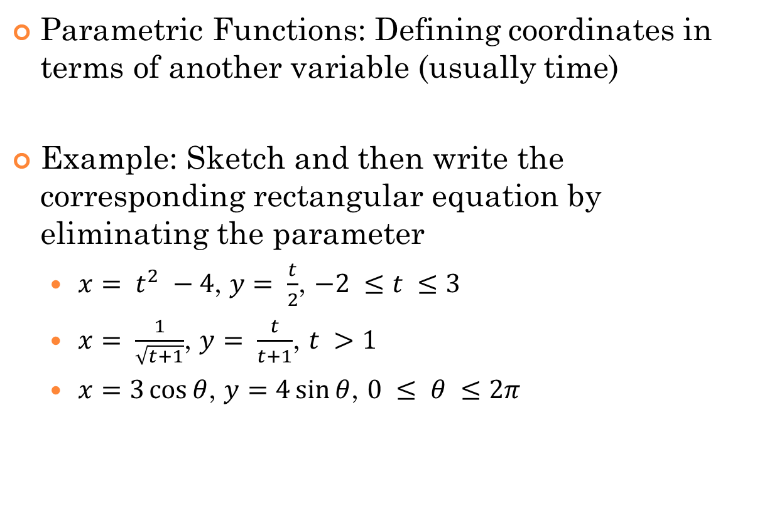
10.1 Parametric Functions
Parametric Functions: Defining coordinates in terms of another variable (usually time)
Example: Sketch and then write the corresponding rectangular equation by eliminating the parameter
  $x= t^{2} −4$, $y= \frac{t}{2}$, $−2 ≤t ≤3$
  $x= \frac{1}{\sqrt{t+1}}$, $y= \frac{t}{t+1}$, $t >1$
  $x=3\cos{θ}$, $y=4\sin{θ}$, $0 ≤ θ ≤2π$

Slide 4
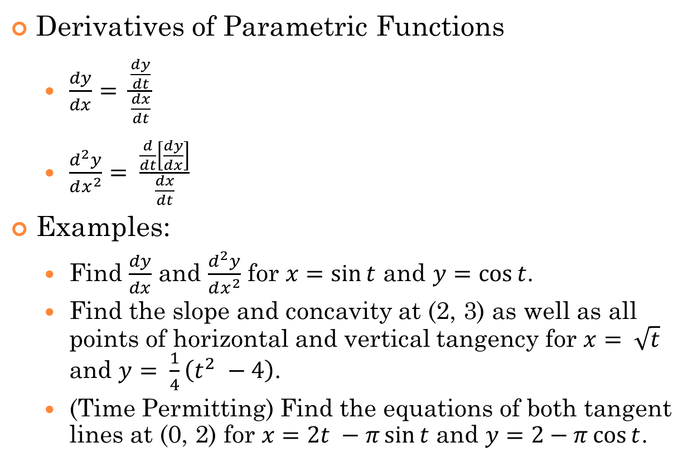
10.1 Parametric Functions
Derivatives of Parametric Functions
  $\frac{dy}{dx}= \frac{\frac{dy}{dt}}{\frac{dx}{dt}}$
  $\frac{d^{2}y}{dx^{2}}= \frac{\frac{d}{dt}\left[\frac{dy}{dx}\right]}{\frac{dx}{dt}}$
Examples:
  Find $\frac{dy}{dx}$ and $\frac{d^{2}y}{dx^{2}}$ for $x=\sin{t}$ and $y=\cos{t}$.
  Find the slope and concavity at (2, 3) as well as all points of horizontal and vertical tangency for $x= \sqrt{t}$ and $y= \frac{1}{4}\left(t^{2} −4\right)$.
  (Time Permitting) Find the equations of both tangent lines at (0, 2) for $x=2t −π\sin{t}$ and $y=2−π\cos{t}$.

Slide 5
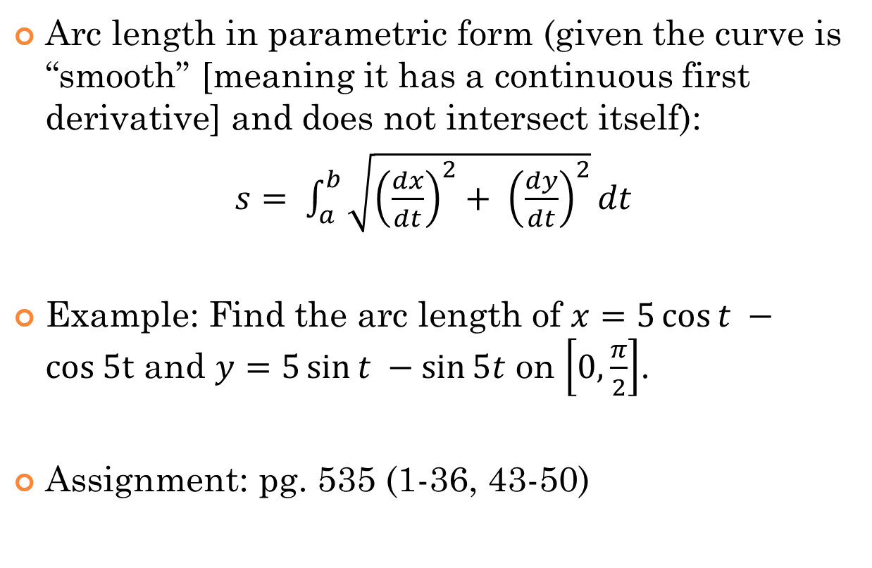
10.1 Parametric Functions
Arc length in parametric form (given the curve is “smooth” [meaning it has a continuous first derivative] and does not intersect itself):
$s= \int_{a}^{b}{\sqrt{{\left(\frac{dx}{dt}\right)}^{2}+ {\left(\frac{dy}{dt}\right)}^{2}}dt}$
Example: Find the arc length of $x=5\cos{t} −cos 5t$ and $y=5\sin{t} −\sin{5t}$ on $\left[0, \frac{π}{2}\right]$.
Assignment: pg. 535 (1-36, 43-50)

Slide 6
Vector Valued Functions
https://www.youtube.com/watch?v=bOIe0DIMbI8
10.2

Slide 7
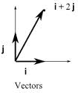
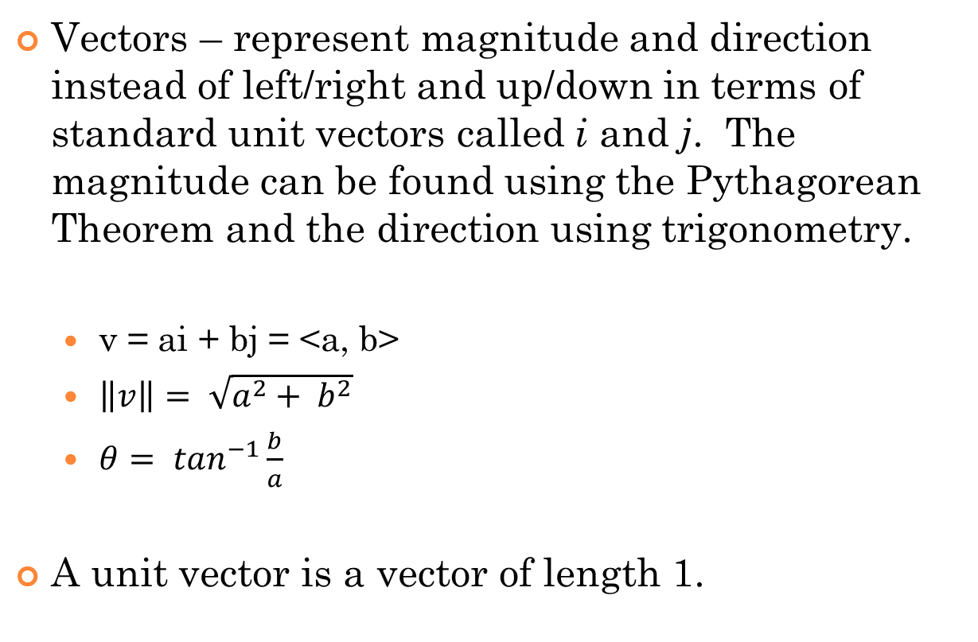
10.2 Vectors
Vectors – represent magnitude and direction instead of left/right and up/down in terms of standard unit vectors called i and j. The magnitude can be found using the Pythagorean Theorem and the direction using trigonometry.
  v = ai + bj = <a, b>
  $\left\|v\right\|= \sqrt{a^{2}+ b^{2}}$
  $θ= \tan^{−1}\frac{b}{a}$
A unit vector is a vector of length 1.

Slide 8
10.2 Vectors
To find a vector given a terminal (or ending) point and an initial (or beginning) point, simply subtract their components terminal – initial.
Example: Find the component form, magnitude, and direction of the vector v that has an initial point (3, -7) and a terminal point (-2, 5). Then find a unit vector in the direction of v.

Slide 9
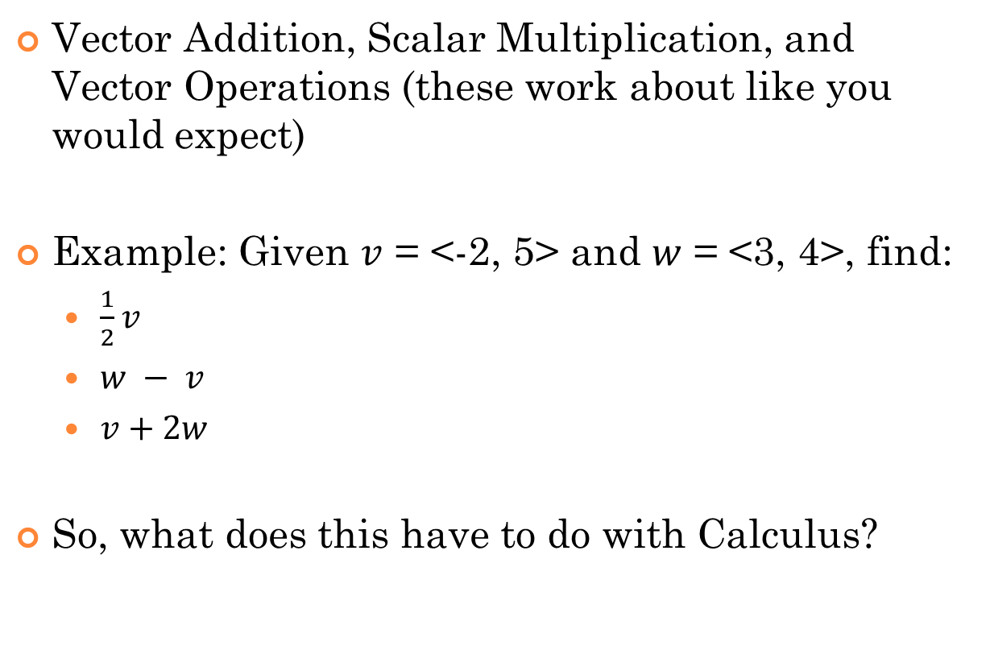
10.2 Vectors
Vector Addition, Scalar Multiplication, and Vector Operations (these work about like you would expect)
Example: Given $v$ = <-2, 5> and $w$ = <3, 4>, find:
  $\frac{1}{2}v$
  $w − v$
  $v+2w$
So, what does this have to do with Calculus?

Slide 10
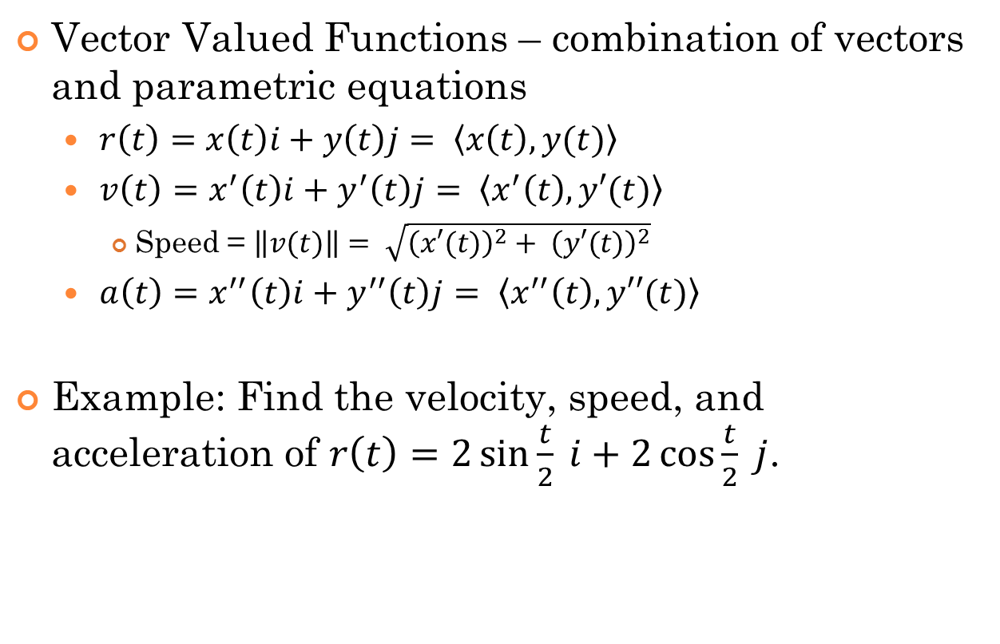
10.2 Vector Valued Functions
Vector Valued Functions – combination of vectors and parametric equations
  $r\left(t\right)=x\left(t\right)i+y\left(t\right)j= \left\langle x\left(t\right), y(t)\right\rangle$
  $v\left(t\right)=x^{′}\left(t\right)i+y^{′}\left(t\right)j= \left\langle x^{′}\left(t\right), y′(t)\right\rangle$
    Speed = $\left\|v(t)\right\|= \sqrt{{\left(x′(t)\right)}^{2}+ {\left(y′(t)\right)}^{2}}$
  $a\left(t\right)=x^{′′}\left(t\right)i+y^{′′}\left(t\right)j= \left\langle x^{′′}\left(t\right), y′′(t)\right\rangle$
Example: Find the velocity, speed, and acceleration of $r\left(t\right)=2\sin{\frac{t}{2}} i+2\cos{\frac{t}{2}} j$.

Slide 11
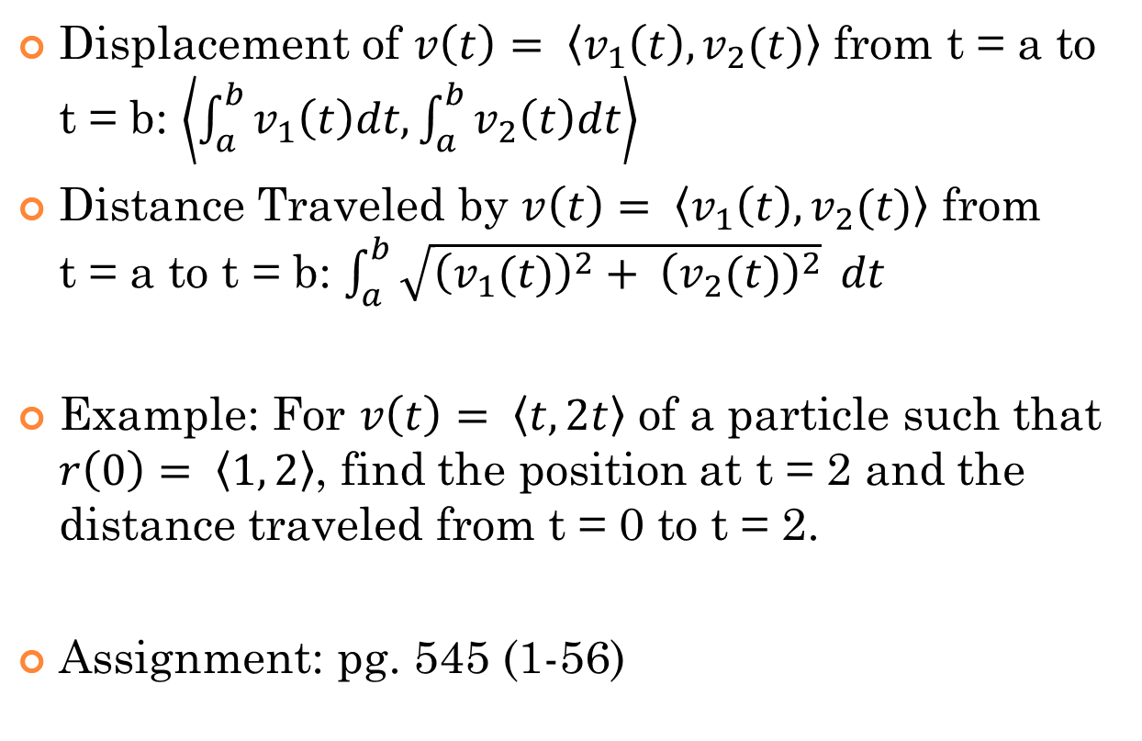
10.2 Vector Valued Functions
Displacement of $v\left(t\right)= \left\langle v_{1}\left(t\right), v_{2}(t)\right\rangle$ from t = a to t = b: $\left\langle \int_{a}^{b}{v_{1}\left(t\right)dt, \int_{a}^{b}{v_{2}\left(t\right)dt}}\right\rangle$
Distance Traveled by $v\left(t\right)= \left\langle v_{1}\left(t\right), v_{2}(t)\right\rangle$ from t = a to t = b: $\int_{a}^{b}{\sqrt{{\left(v_{1}(t)\right)}^{2}+ {\left(v_{2}(t)\right)}^{2}}} dt$
Example: For $v\left(t\right)= \left\langle t, 2t\right\rangle$ of a particle such that $r\left(0\right)= \left\langle 1, 2\right\rangle$, find the position at t = 2 and the distance traveled from t = 0 to t = 2.
Assignment: pg. 545 (1-56)

Slide 12
Polar Functions
10.3

Slide 13
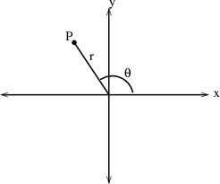
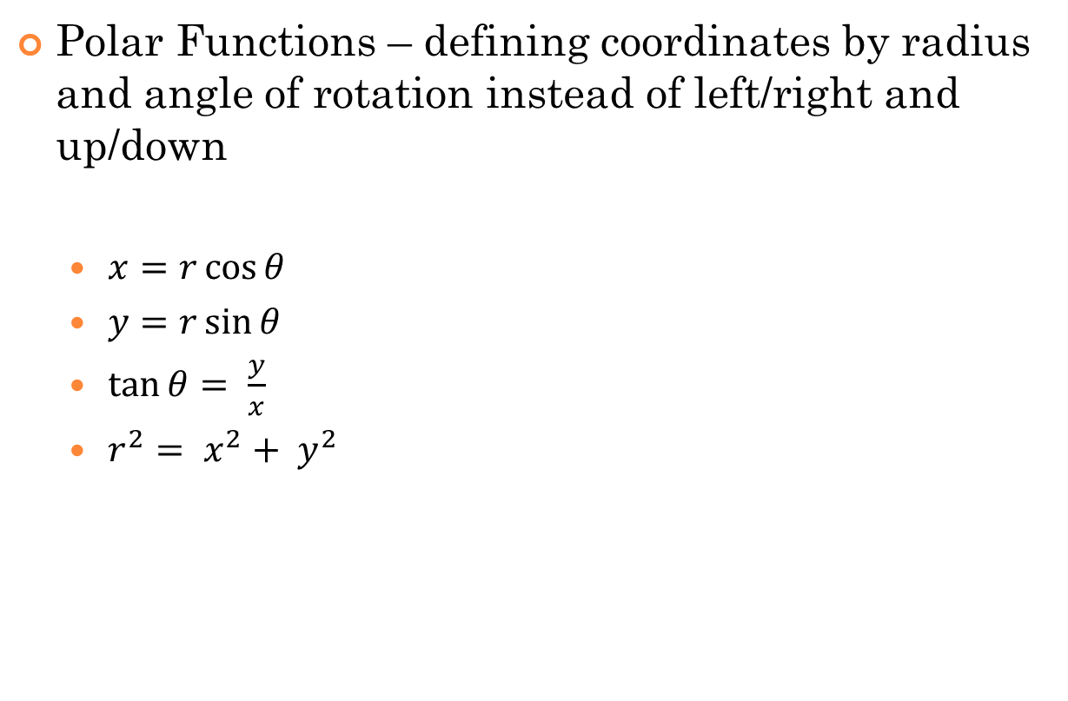

10.3 Polar Functions
Polar Functions – defining coordinates by radius and angle of rotation instead of left/right and up/down
  $x=r\cos{θ}$
  $y=r\sin{θ}$
  $\tan{θ= \frac{y}{x}}$
  $r^{2}= x^{2}+ y^{2}$
Point P is labeled (r, $θ$)
The positive x-axis is called the “polar axis”
The origin (0, 0) is called the “pole”

Slide 14
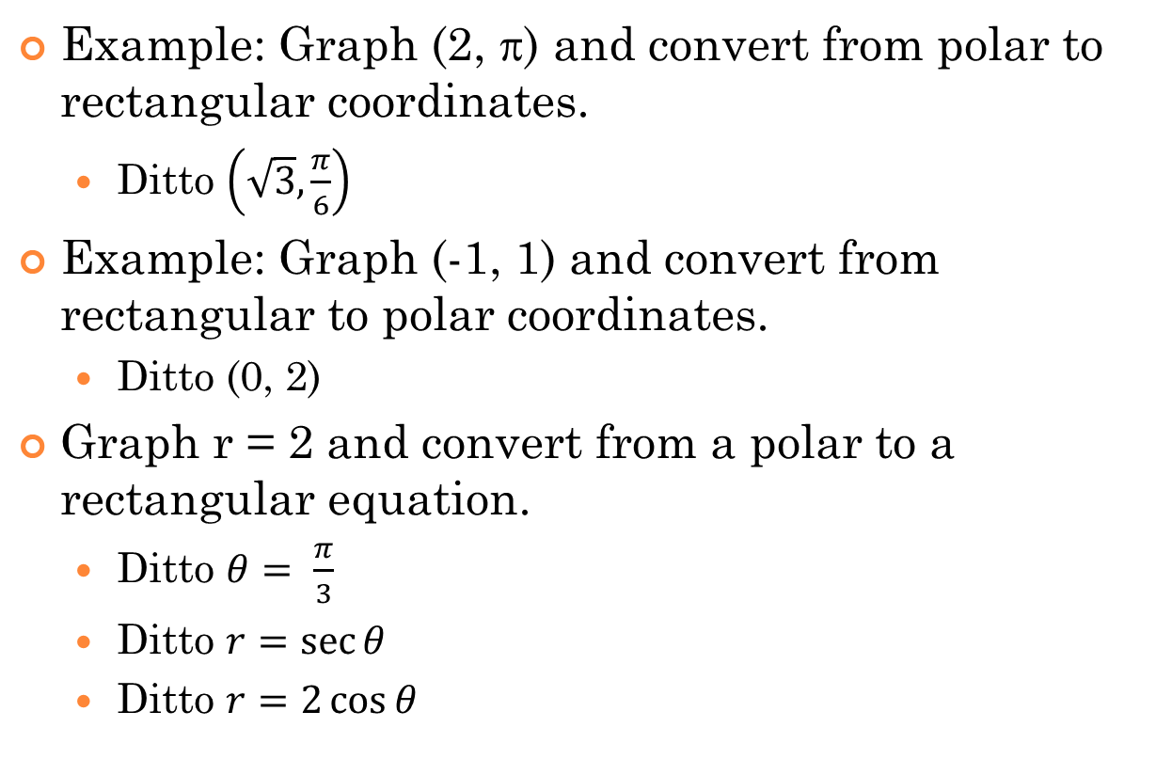
10.3 Polar Functions
Example: Graph (2, ) and convert from polar to rectangular coordinates.
  Ditto $\left(\sqrt{3}, \frac{π}{6}\right)$
Example: Graph (-1, 1) and convert from rectangular to polar coordinates.
  Ditto (0, 2)
Graph r = 2 and convert from a polar to a rectangular equation.
  Ditto $θ= \frac{π}{3}$
  Ditto $r=\sec{θ}$
  Ditto $r=2\cos{θ}$

Slide 15
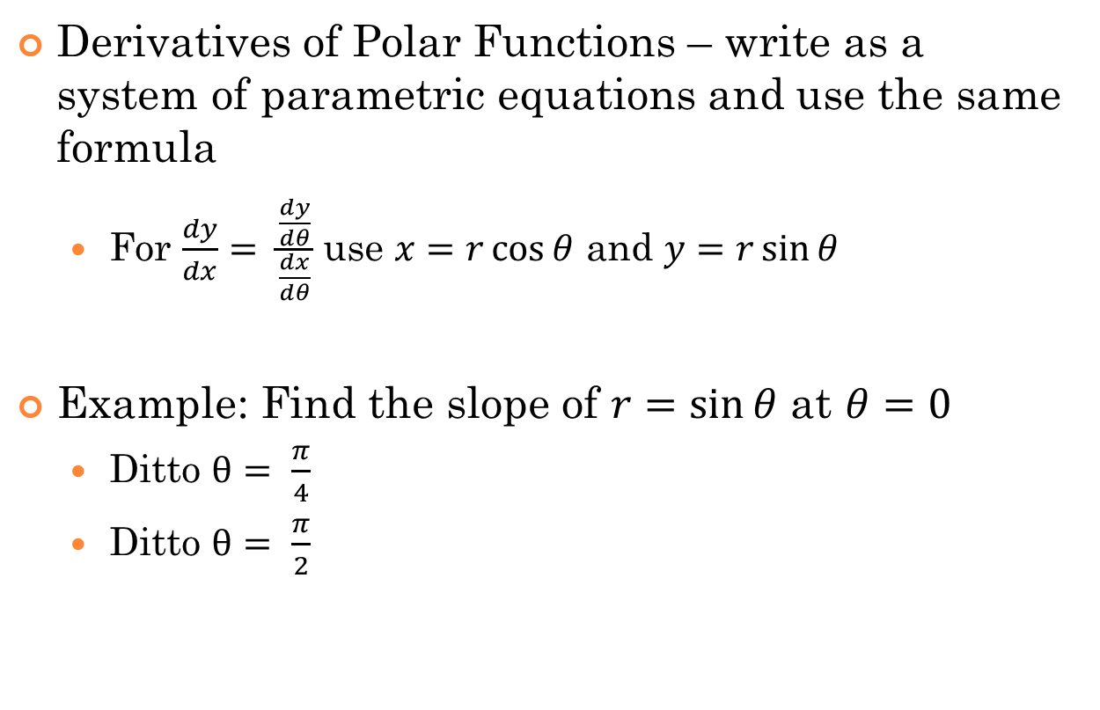
10.3 Polar Functions
Derivatives of Polar Functions – write as a system of parametric equations and use the same formula
  For $\frac{dy}{dx}= \frac{\frac{dy}{dθ}}{\frac{dx}{dθ}}$ use $x=r\cos{θ}$ and $y=r\sin{θ}$
Example: Find the slope of $r=\sin{θ}$ at $θ=0$
  Ditto $θ= \frac{π}{4}$
  Ditto $θ= \frac{π}{2}$

Slide 16
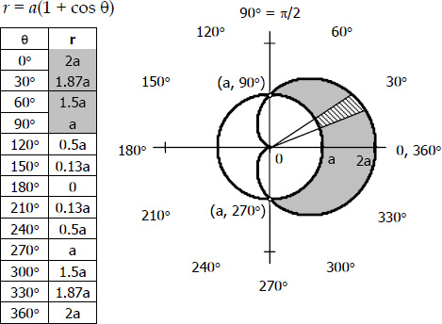
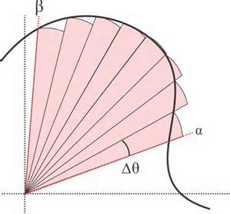

10.3 Polar Functions
Area in Polar Coordinates: $A= \frac{1}{2}\int_{α}^{β}{r^{2}dθ}$
Notes:
Mention how area is found in polar coordinates – it’s not top – bottom!

Slide 17
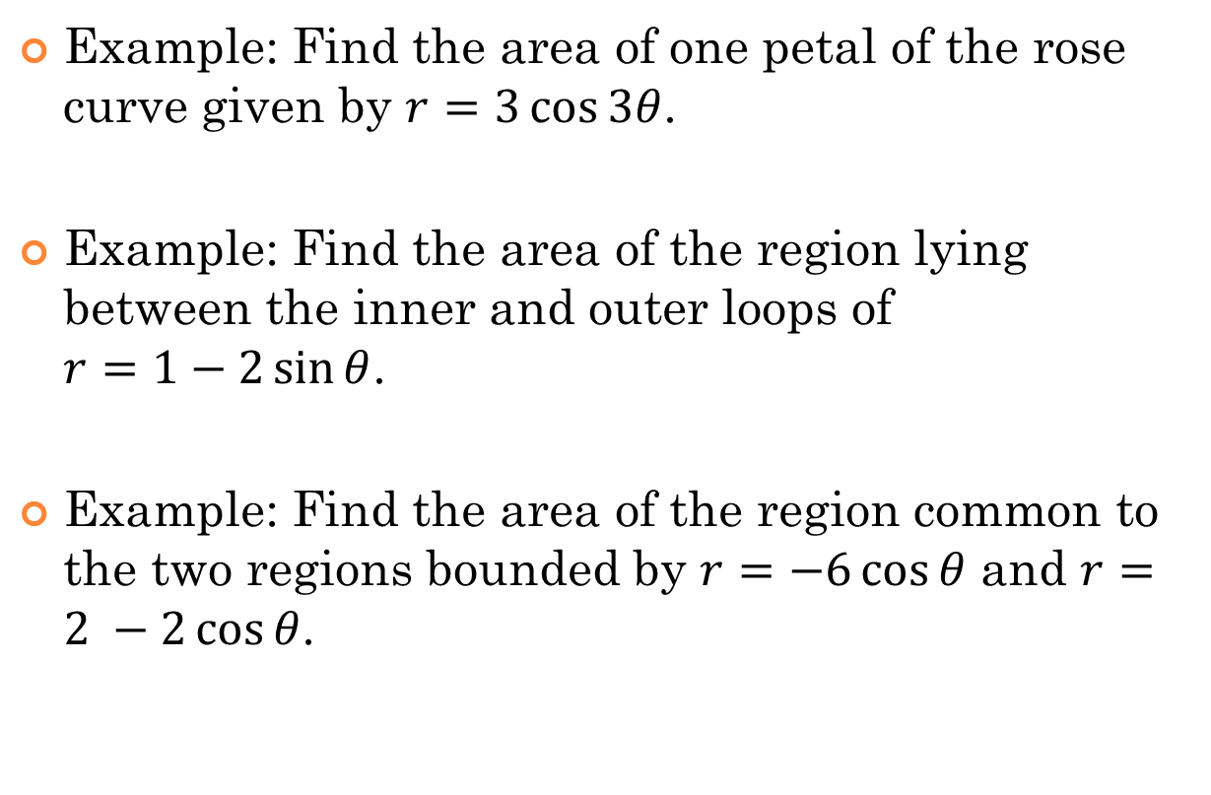
10.3 Polar Functions
Example: Find the area of one petal of the rose curve given by $r=3\cos{3θ}$.
Example: Find the area of the region lying between the inner and outer loops of $r=1−2\sin{θ}$.
Example: Find the area of the region common to the two regions bounded by $r=−6\cos{θ}$ and $r=2 −2\cos{θ}$.
Notes:
Mention how area is found in polar coordinates – it’s not top – bottom!

Slide 18
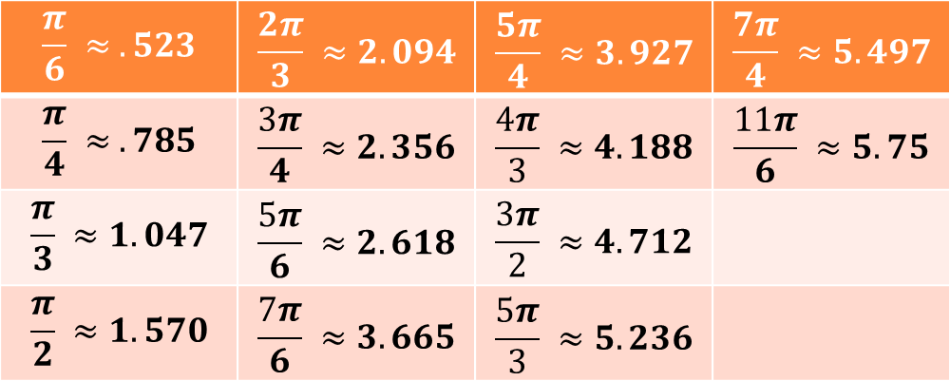

10.3 Polar Functions
Some important values to recognize (as you should already recognize multiples of $π$)
$$\frac{π}{6} ≈ .523$$ | $$\frac{2π}{3} ≈2.094$$ | $$\frac{5π}{4} ≈3.927$$ | $$\frac{7π}{4} ≈5.497$$
$$\frac{π}{4} ≈ .785$$ | $$\frac{3π}{4} ≈2.356$$ | $$\frac{4π}{3} ≈4.188$$ | $$\frac{11π}{6} ≈5.75$$
$$\frac{π}{3} ≈1.047$$ | $$\frac{5π}{6} ≈2.618$$ | $$\frac{3π}{2} ≈4.712$$
$$\frac{π}{2} ≈1.570$$ | $$\frac{7π}{6} ≈3.665$$ | $$\frac{5π}{3} ≈5.236$$

Slide 19
10.3 Polar Functions Project
Design a sign that can be hung advertising a fund raiser for C.A.L.C. Club. You will be given a card with a required curve, the parameters for building the curve, and the required area for that curve.
Your sign must include:
  a graph of the curve.
  the name and equation of the curve.
  the area of the curve.
  the item to be advertised
Your explanation for how you know that your curve has the required area can also appear on the sign or separately.
(The signs may actually be used in C.A.L.C. Club advertising. If you want your name to be on the front with your advertisement, that is fine. If you do not want your name shown with the design, put your name on the back or on a sticky note.)
Assignment: pg. 557 (1-66)
Project: due TBD

